Slide 1
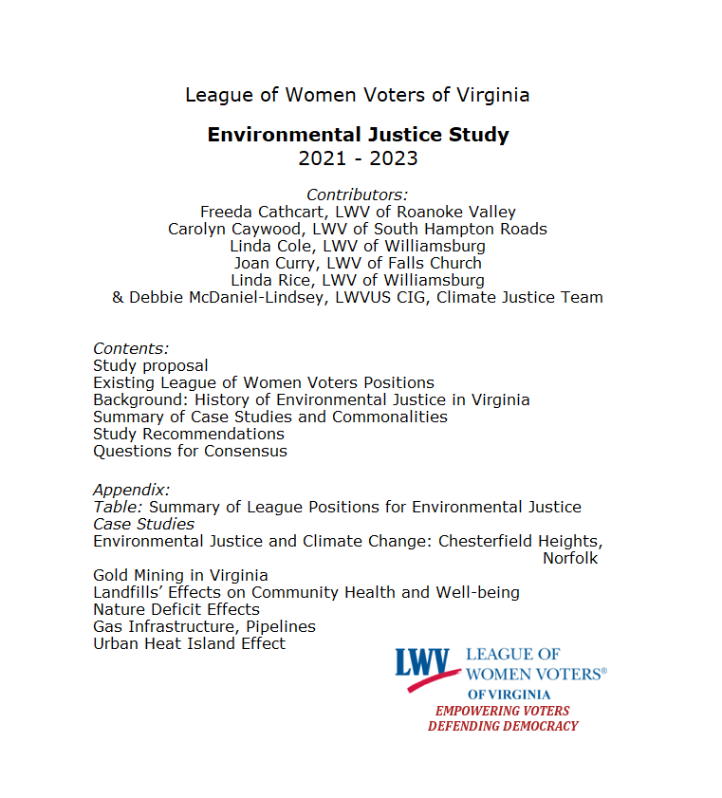
Notes:
Thanks to everyone who worked on the study, including Anna Weber, Freeda Cathcart, and Lisa Hilgartner.

Slide 2
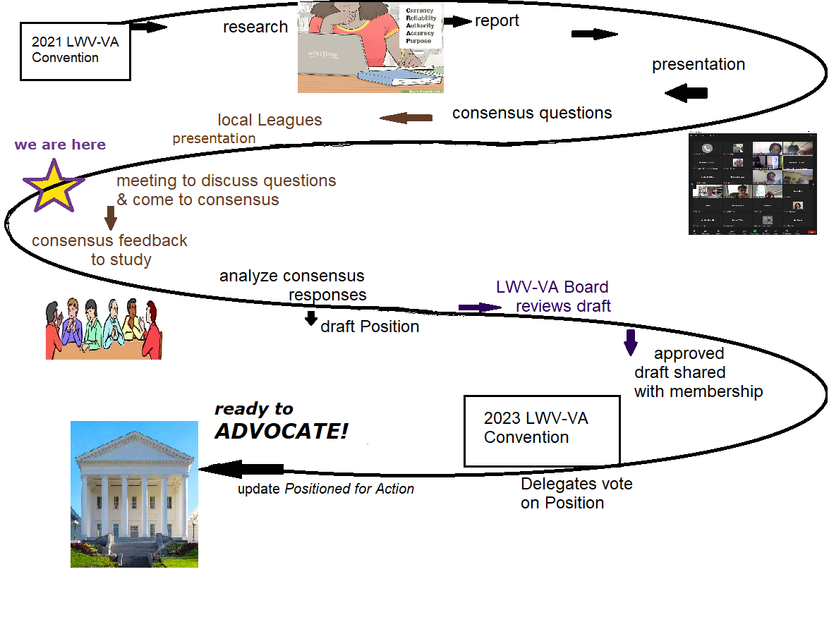
What’s a Study for?
League Program
Notes:
All League advocacy is based on our Positions. Each position was developed through a Study. Studies are thorough and unbiased – no cherry-picking data to justify assumptions. Positions are reviewed every other year. Program is the League name for the cycle of study and position review that ensures that our positions are factually up-to-date and grounded in the values of League members. It’s why our advocacy carries weight and isn’t easily ignored

Slide 3
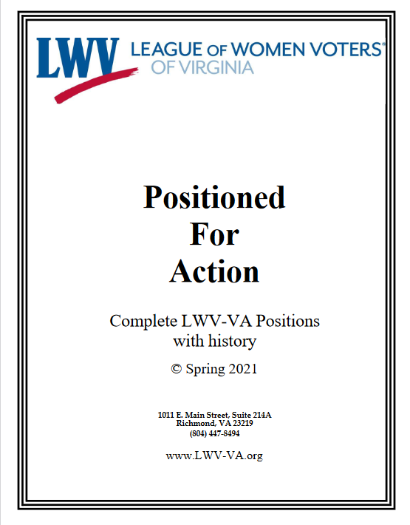
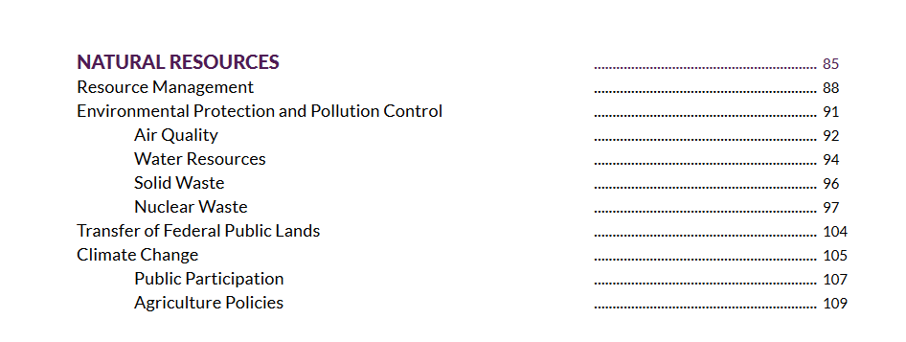
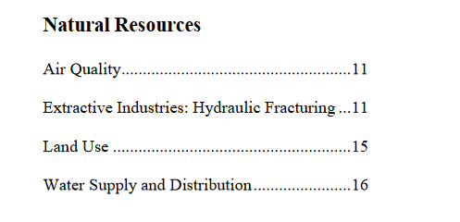
Existing Positions
Notes:
Study members combed through all the Virginia and national positions under Natural Resources looking for concepts related to environmental justice. Only the most recently adopted acknowledged that the impacts of environmental damage are not shared equally. The LWVUS Position on Public Participation touches on part of the Environmental Protection Agency’s definition of Environmental Justice – meaningful involvement.

Slide 4
Environmental Justice defined
“Environmental justice is the fair treatment and meaningful involvement of all people regardless of race, color, national origin, or income, with respect to the development, implementation, and enforcement of environmental laws, regulations, and policies.
This goal will be achieved when everyone enjoys:
The same degree of protection from environmental and health hazards, and
Equal access to the decision-making process to have a healthy environment in which to live, learn, and work.”
– Environmental Protection Agency
Notes:
The 2020 Virginia Environmental Justice Act adopted the first sentence of the EPA definition, making that law in VA. State law goes on to define "Meaningful involvement" means the requirements that (i) affected and vulnerable community residents have access and opportunities to participate in the full cycle of the decision-making process about a proposed activity that will affect their environment or health and (ii) decision makers will seek out and consider such participation, allowing the views and perspectives of community residents to shape and influence the decision.” Article 12. Virginia Environmental Justice Act. § 2.2-234. Definitions.

Slide 5
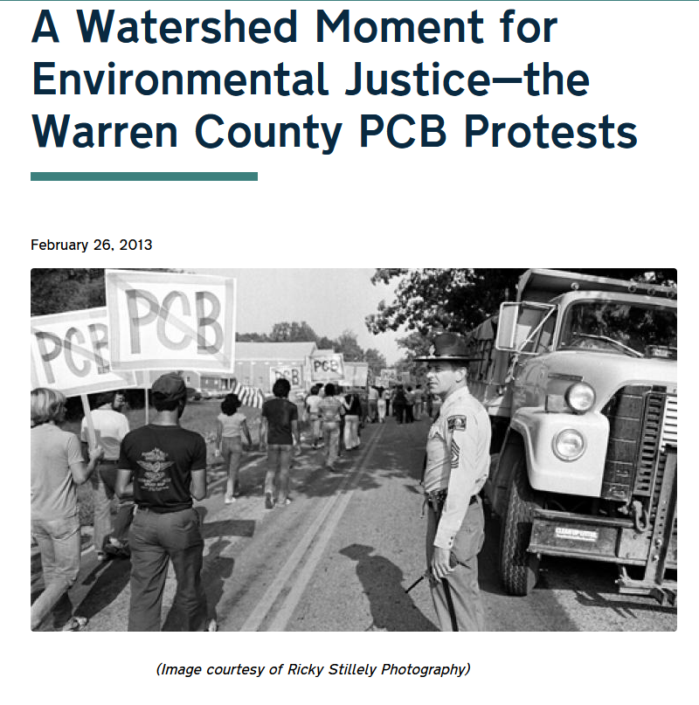
History of Environmental Justice
Notes:
Many incidents & protests before 1982 protest against Warren County, N.C. PCB Landfill got national attention and EJ became a named movement. EPA began addressing EJ in the 1990s.
But in VA, not much until this last decade.

Slide 6
Timeline of Environmental Justice in Virginia
2014 Dan River coal ash spill
2015 Virginia Environmental Justice Collaborative forms to advocate for:
2017 Governor’s Advisory Council on Environmental Justice (ACEJ) Exec. Order
2019 Air Board vote permits Union Hill compressor station
2019-20 4th Circuit Court of Appeals rejects Union Hill compressor station
(Friends of Buckingham County, CBF, v State Air Pollution Control Board, DEQ)
2019-20 DEQ commissions the “SKEO report”
2020 Virginia Environmental Justice Act
2020 Virginia Council on Environmental Justice codified
2020 VA Interagency Environmental Justice Working Group (in budget language)
2021 Air Board votes “No” on Lambert compressor station
2022 Legislators remove permitting power of citizen environment boards
Notes:
[2014-2022]
[Environmental orgs’ DEI reckoning.
2014 Dan River coal ash spill.
Climate change.]
(2015-20) The Atlantic Coast Pipeline’s Union Hill compressor station galvanized activists and drew a rebuke from the court that meaningful community involvement was not merely a check-off box.

Slide 7
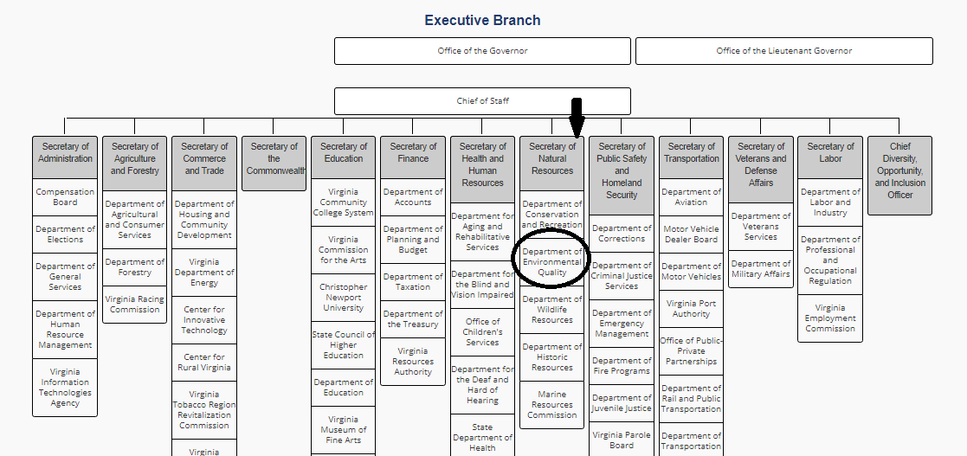
Virginia Department of Environmental Quality (DEQ)
Notes:
Finally in 2019, state government began to act, both the legislature and the administration. The Dept. of Environmental Quality commissioned an outside study that reported in Oct. 2020. That report’s conclusions are one of our study’s recommendations, so let’s look at them.

Slide 8
Environmental Justice Study for VA DEQ
Authority: Strengthen and clarify legal and statutory authority to integrate environmental justice into DEQ programs.
2. Leadership: Foster subject matter understanding and cohesive support for environmental justice among DEQ leadership.
3. Staff Capacity: Increase staff clarity and capacity to effectively support environmental justice and apply environmental justice considerations throughout DEQ programs.
4. Guidance and Tools: Provide guidance and tools to ensure clear and consistent implementation of adopted environmental justice policies and practices.
Notes:
The report identified nine goals and spelled out specific recommended actions under each, to be addressed in three phases. The first four goals are more internal. And the legislation passed in 2020 strengthened authority.
But the change in administrations changed the goals and direction of DEQ. Example: the director of EJ position was reclassified as a manager.

Slide 9
DEQ Environmental Justice Study
5. Accessible Information: Develop tools to provide more transparent, accessible and real-time environmental information to the public.
6. Relationship Building: Invest in proactively building productive relationships with environmental justice and other adversely impacted communities.
7. Community Engagement: Proactively and authentically engage communities on issues and decision-making that could potentially affect their health and quality of life.
8. Environmental Justice Community Capacity: Build the capacity of environmental justice communities to participate meaningfully in environmental decision-making.
9. Local Government Coordination: Invest in local government coordination and education to ensure alignment with environmental justice policies.
Notes:
Goals five through nine focus on outreach,
reducing government silos, and especially meaningful involvement with all stakeholders.
transparent, accessible, timely
proactive & authentic engagement
build EJ community capacity to participate

Slide 10
Virginia Regulatory Town Hall
Notes:
As you can see a lot of environmental justice advocacy involves regulatory and permitting bodies that work year around. We believe League members need to understand how the executive branch of VA government is organized and prepare to advocate year around. The VA Regulatory Town Hall is as important to keeping up with the executive branch of government as LIS is to tracking legislation.

Slide 11
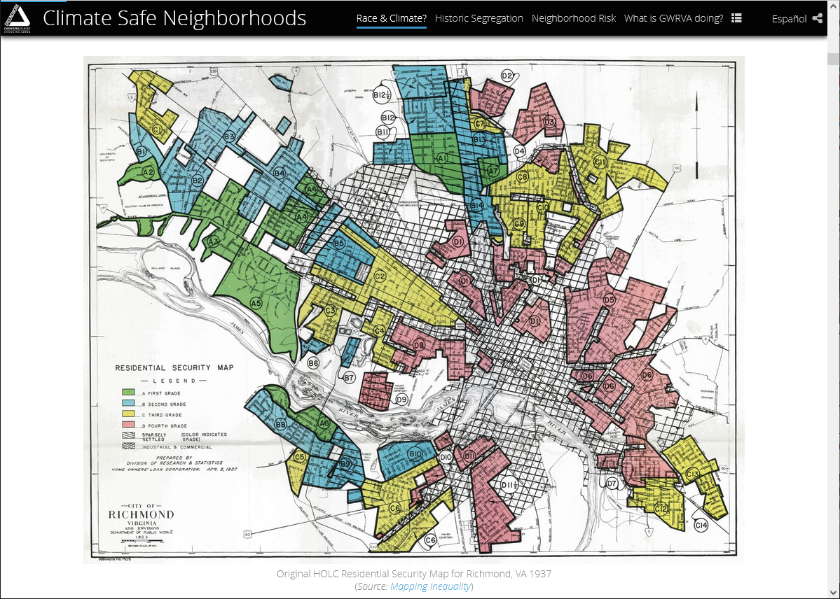
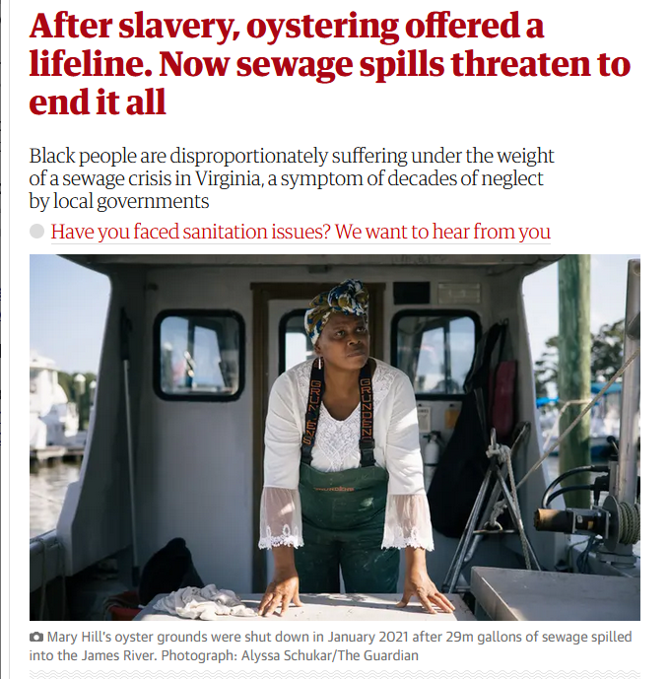
Legacy Injustice
Environmental burdens have been greatest for those who have received the least benefit.
Redlining Richmond
Notes:
1. Environmental burdens have been greatest for those who have received the least benefit. Deliberate decisions in the past have left an unjust legacy. We need to push government bodies to study hazard & zoning maps, scrutinize their procedures, and work to end systemic environmental injustice in the face of climate change threats.

Slide 12
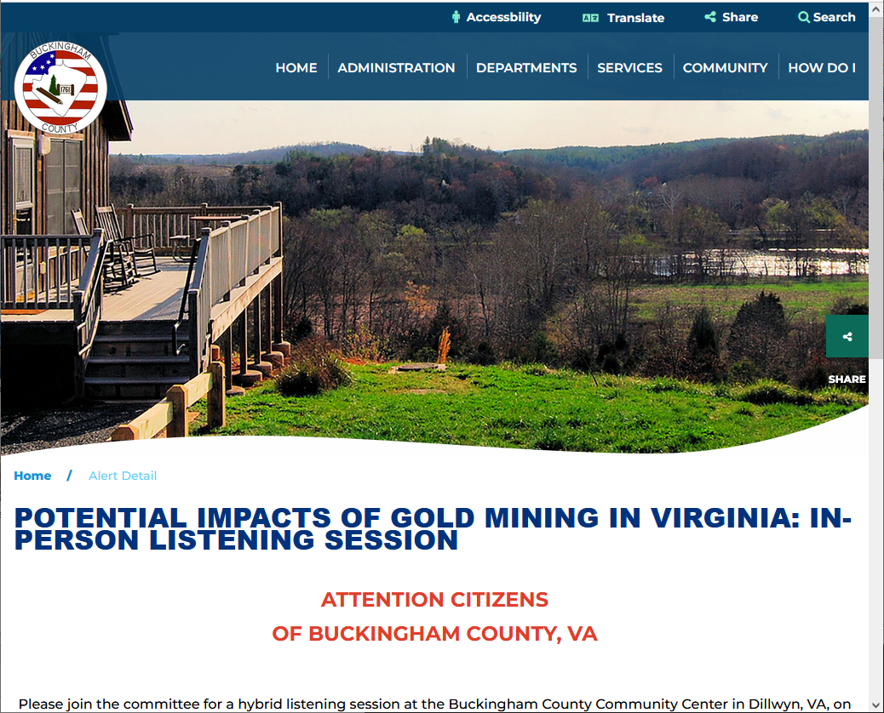
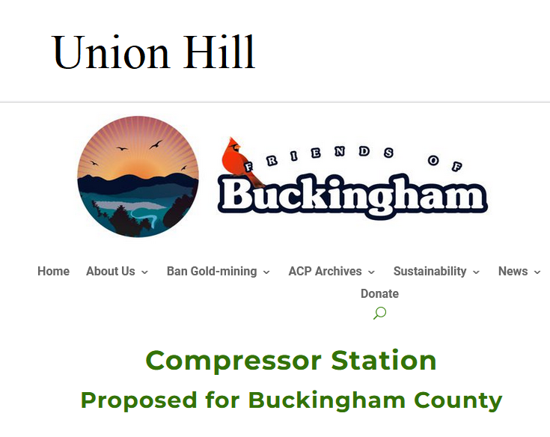
Cumulative Impacts
Notes:
2. Advocate for including cumulative, downstream and long term impacts in evaluating projects and permits. The practice of evaluating each project by itself favors the developer over the local residents. And developers go where the land is cheap or the residents lack means to fight back. They were wrong about Buckingham County [gold mine, compressor]

Slide 13
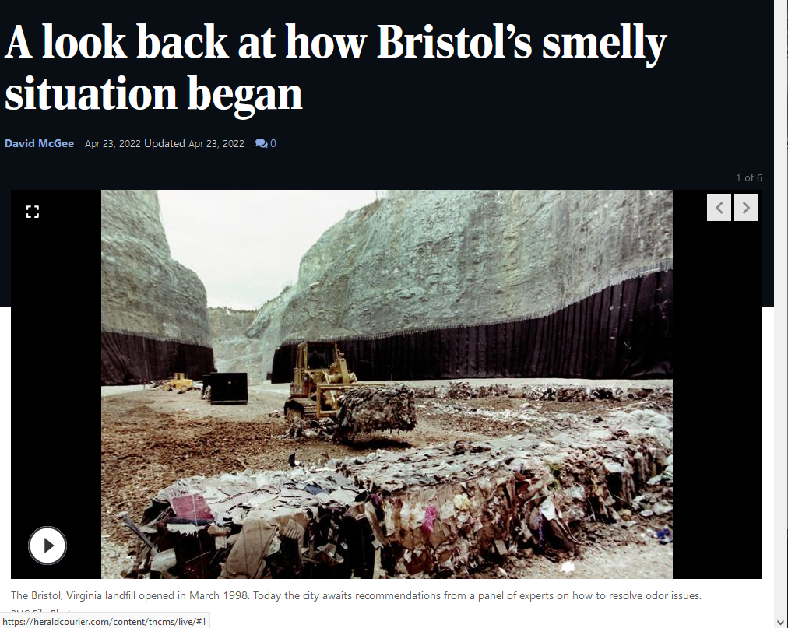
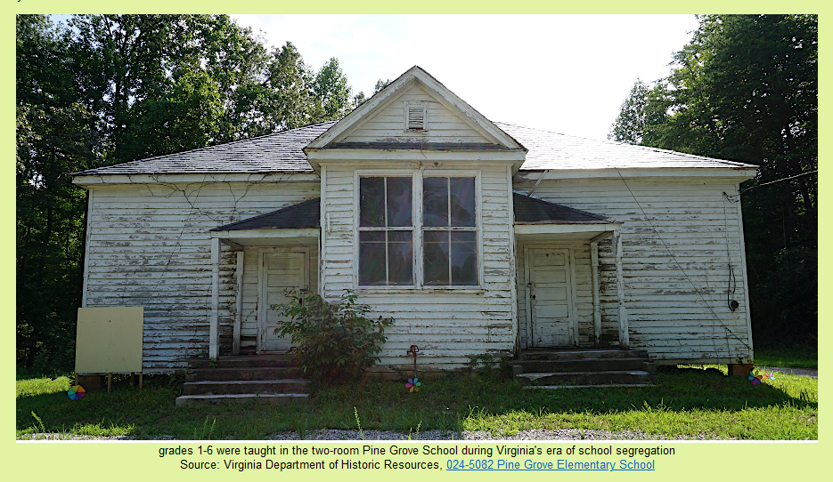
More than Pollution, All Effects
Noise, odors...
Loss of
historical connection
Notes:
3. Advocate for considering all effects of a project. League positions have long covered air & water quality and solid waste safety hazards. But a healthy environment requires more. Loud continual noise and vibration, bright light all night, strong odors, lack of tree canopy or green spaces, and loss of historic or cultural touchstones can make life unbearable for residents. [Bristol landfill, Pine Grove school[

Slide 14
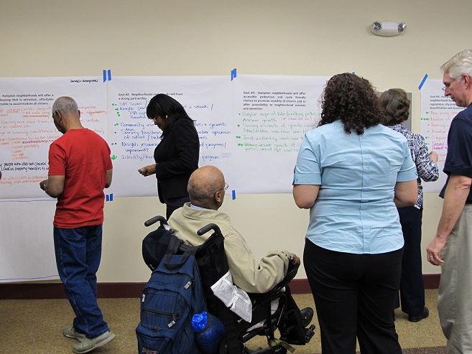
Meaningful Involvement
Early in the process
Shapes the outcome
Outreach to all stakeholders
Timely, accessible, understandable information
Notes:
4. Hold DEQ, and other government agencies and boards, accountable for meaningful involvement of all stakeholders, early in a project. DEQ must provide transparent, accessible, and real-time environmental information to the public. More, DEQ ‘s outreach to local residents must reach them and be understood by them. [Hampton comp plan]

Slide 15
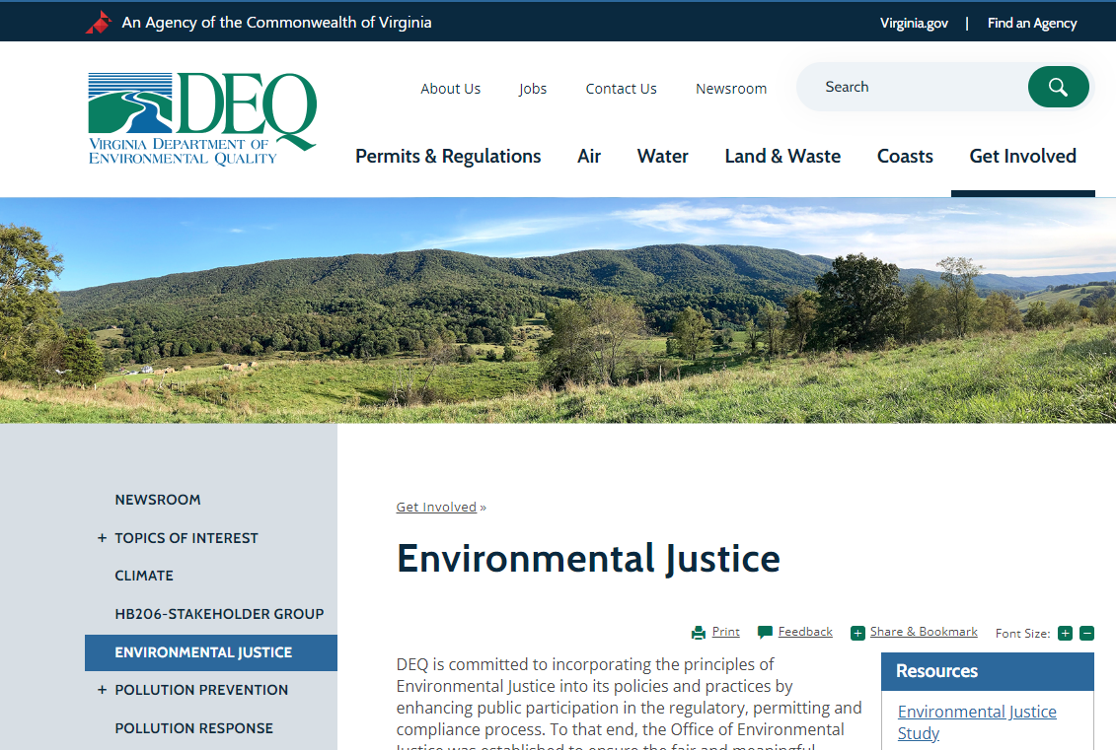
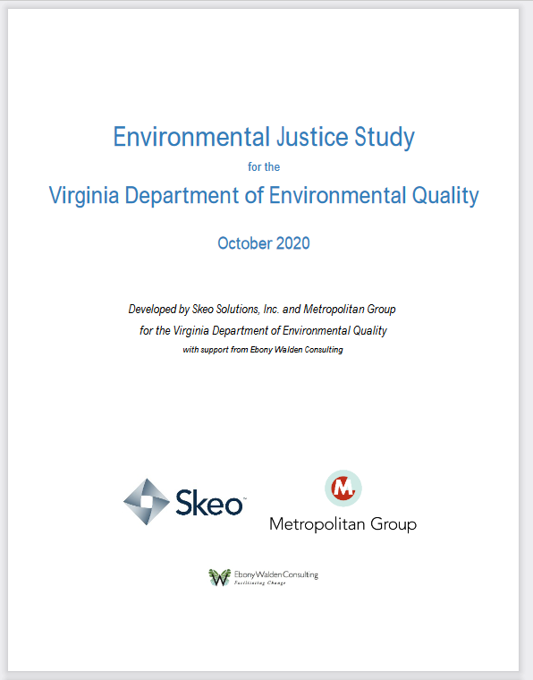
Implement DEQ’s Environmental Justice Study
Notes:
5. Advocate that DEQ return to implementing its Environmental Justice Study and develop staff capacity and clear guidance “to effectively support environmental justice and apply environmental justice considerations throughout DEQ programs.” [SKEO report]

Slide 16
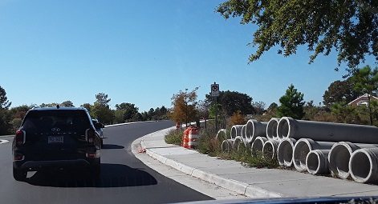
Information-Sharing & Coordination
Notes:
6. Advocate for information-sharing and coordination among state, regional, and local agencies responsible for agriculture, comprehensive planning, economic development, emergencies & public safety, environment, housing, health, parks, and transportation. Coordination is especially critical for climate change threats. [Chesterfield Heights – positive example, involved multiple levels of government, university, environmental organization ]

Slide 17
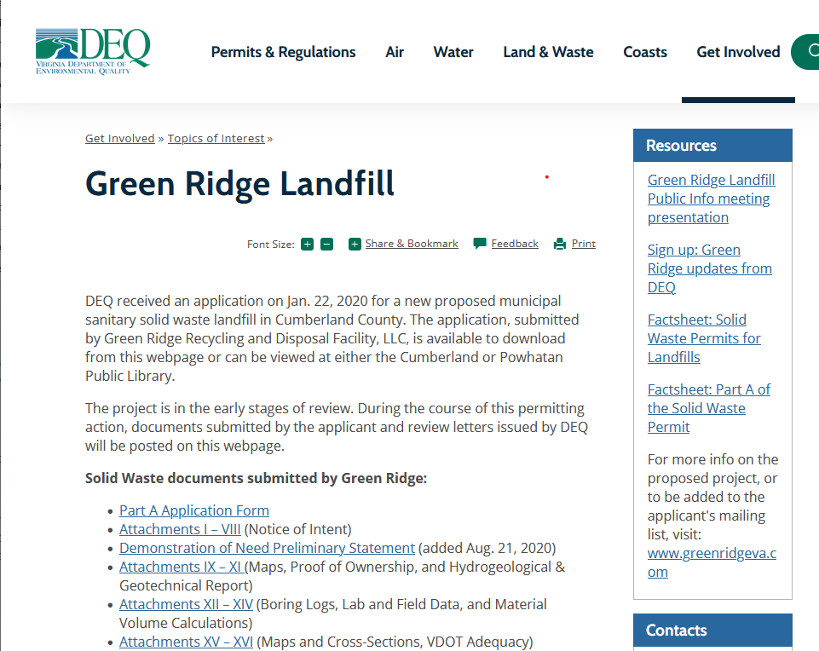
Provide Expertise
Notes:
7. Advocate for the state to provide expertise to help localities with a small tax base to assess and find solutions to environmental justice issues. [Green Ridge – positive example]

Slide 18
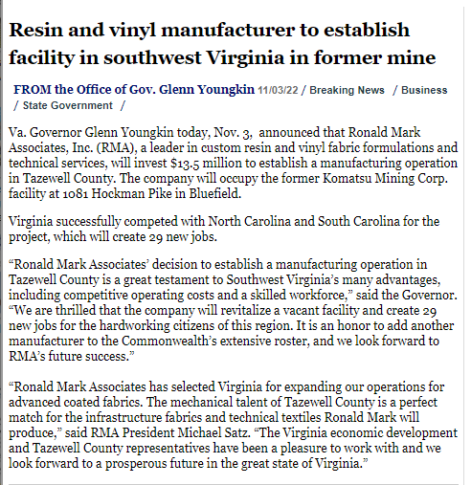
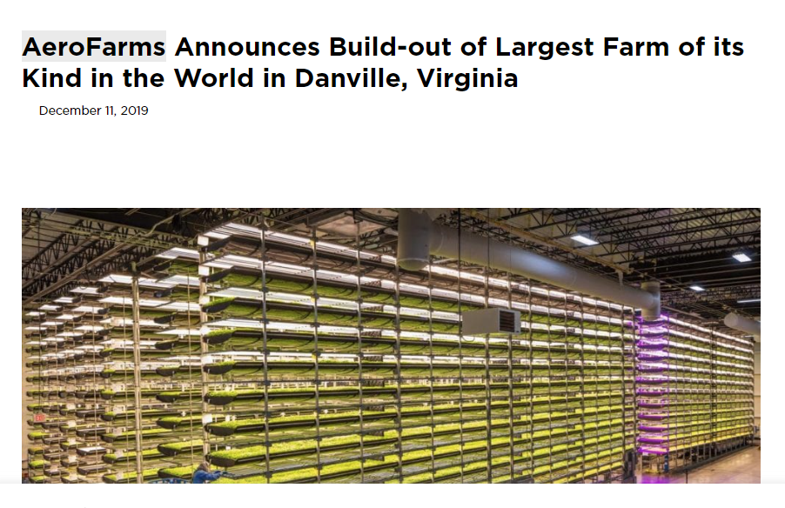
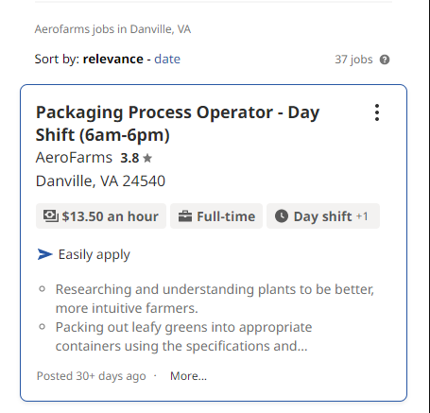
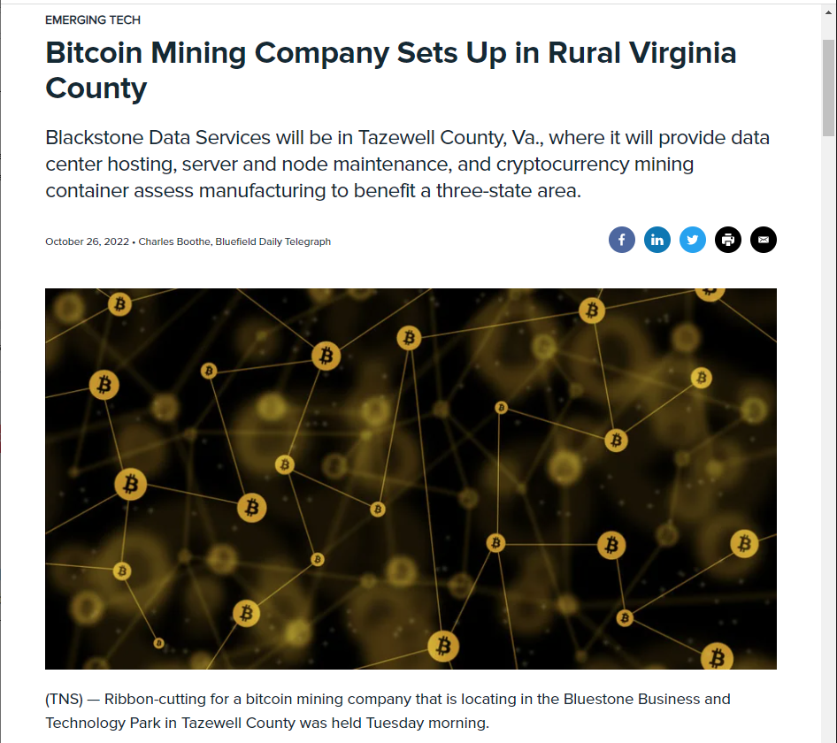
Independent Environmental Justice Analysis
Notes:
8. Advocate for funding for independent environmental justice analyses before major permitting decisions v. often unsubstantiated claims of benefits by a developer – Jobs! Revenue! [three businesses moving to south and west counties]

Slide 19
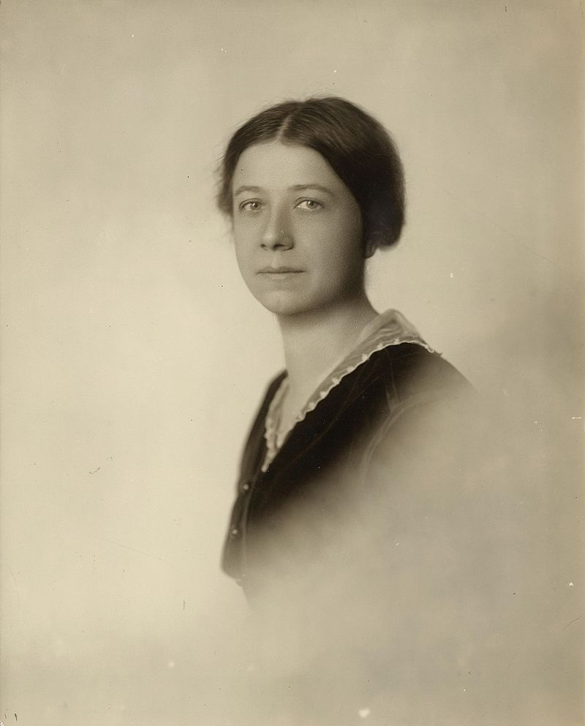
Next Step, Consensus
“Action without study is fatal. Study without action is futile.”
– Mary Ritter Beard,
suffragist
Notes:
A final thought.

Slide 20
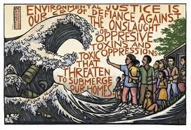
Questions?
Carolyn Caywood, program@lwv-va.org
Notes:
Contact me if questions come up later.
https://docs.google.com/document/d/11wDehXuhZY9LhZ7IdxcyfV6-0sJVozjh/edit?usp=sharing&ouid=108204542125106087466&rtpof=true&sd=true

