Slide 1
League of Women Voters—Virginia
How Virginia Funds Its Public Schools:
A Study of Equity in Public Education
August 27, 2022
Notes:
Slide 1: At its 2021 Convention, the League of Women Voters of Virginia approved a study of education equity in the Commonwealth.

Slide 2
League of Women Voters Education Equity Study Committee
Executive Committee
Co-chairs - Merry Jennings & Elizabeth Obenshain, LWV-VA Program Chair - Carolyn Caywood, Margaret Christle, Larkin Dudley, Ann Fisher, Keith Perrigan, Robin Smith, Wayne “Dempsey” Worner
Subcommittee I (What is a high-quality education?): Chair - Margaret Christle (LWV-MC), William “Buckey” Boone (LWV-WC), Vicky Greco (LWV-SHR), Kassidy Slaughter (LWV-WC), Marva Wheeler (LWV-WC), Merry Jennings (LWV-WC)
Subcommittee II (Is VA funding equitable?): Chair - Robin Smith (LWV-MAL), Carol Brunty (LWV-WC), Ann Fisher (LWV-MC), Priscilla Godfrey (LWV-LC), Gunin Kiran (LWV-MC), Keith Perrigan LWV-WC), Tonja Roberts (LWV-MAL), Martha Stewart LWV-SHR), Wayne “Dempsey” Worner (LWV-MC)
Subcommittee III (How does VA compare?): Chair - Larkin Dudley (LWV-MC), Charity Boyette LWV-MC), Brenda Beebe Duncan LWV-WA), Connie Froggatt LWV-MC), Carol Noggle LWV-PWA), Beth Obenshain (LWV-MC), Wayne “Dempsey” Worner (LWV-MC)
Notes:
Slide 2: League members from across the state set out to research and document whether all children in Virginia have access to a high quality education and, if not, what changes need to be made in funding public schools.

Slide 3
Notes:
Slide 3: Our three subcommittees:
defined high-quality education;
looked at whether VA’s education funding was equitable, considering the wide disparity in capacity and funding between divisions;
compared how Virginia ranks among states in basic funding for education.
We hope you have read our full report, which gives a clearer and wider view of this complex issue than this presentation.

Slide 4
Why the League believes in public schools
A high-quality education is a foundation for our democracy.
A high-quality education is essential to provide students the intellectual skills for becoming active citizens.
Public education is available to all children despite their family’s wealth, ethnicity, religion, or other factors.
Notes:
Of course, we all know why the League believes public education is so important.

Slide 5
Did you know. . .
Virginia is the 10th wealthiest state, yet in per-pupil funding by the state, Virginia ranks 41st?
Notes:
Joining states such as Mississippi and Missouri.

Slide 6
Our Findings
Our study indicates that state funding of local schools is both inadequate and inequitable.
The Virginia Constitution states that the General Assembly “shall seek to ensure that an educational program of high quality is established and continually maintained.”
Notes:
SLIDE #6
Fundamentally, our study provides evidence that
the state’s funding of public education is both inadequate and inequitable;
Virginia has the resources to adequately fund the schools but not the will;
we have the ability to assess the capacity of local school divisions and design formulas that will fund public schools in a way that will provide a high quality education program for ALL students in Virginia’s public schools.
Part of the problem is the Constitution.

Slide 7
The problem with Virginia’s Constitution
The difference between “shall seek to ensure” and “shall provide”
“The General Assembly shall provide for a system of free public elementary and secondary schools for all children of school age throughout the Commonwealth and shall seek to ensure that an educational program of high quality is established and continually maintained.”
Notes:
SLIDE #7
Standards for a high-quality education are established by the State Board of Education in the Standards of Quality, a document that is subject to periodic approval and funding by the General Assembly. The General Assembly has consistently underfunded the Standards of Quality recommendations they approve.
Our study concluded that unless the language in the Virginia Constitution that describes the state’s obligation to provide “a high-quality education for all students” is changed from aspirational to a requirement, not much is likely to change. Other states have successfully brought court action to force states to increase school funding based on their state constitution’s stronger language.

Slide 8
Virginia’s education ranking
Invested $4.3 billion less in education in 2021 than the average of other states with comparable household incomes
10th wealthiest state, yet in per-pupil funding by the state, ranks ranks 41st
Average teacher pay 10% below the national average in 2020; starting teacher salaries ranked 25th nationwide
Earned a D in education funding from the Education Law Center
Notes:
Slide 8: There are clearly state-wide problems with Virginia’s educational funding.

Slide 9
Funding gaps within the state $200,000 difference per classroom
Localities – not the state - bear the majority of the cost of public education.
Localities spent $4.4 billion above the required effort for SOQ.
Per-pupil funding varies by thousands of dollars per pupil depending on where a student lives and goes to school.
For example: Arlington: $19,744/pupil
Norton: $9,707/pupil
Notes:
Slide 9: Per pupil expenditure across the state varies as much as $10,000 per student and over $200,000 per classroom. In 2020, local governments invested an additional $4.4 billion statewide to provide important education services that exceeded the Standards of Quality requirements. Poorer school divisions do not have the resources to provide the same level of personnel, programs, and services as wealthier school divisions. Full funding by the state for these additional programs and services would reduce some of these inequities.
Rural areas have borne the brunt of state funding cuts. The state share of funding has decreased by 5.4% statewide but is down by 6.8% in rural schools. Staff-to-student ratios have improved statewide but have also decreased in rural schools.

Slide 10
Lee County elementary school
Notes:
Slide 10: In this elementary school classroom in rural Lee County, pupils study among trash cans that catch rain from the school’s leaking roof. During a tour of schools in King and Queen County, a Virginia Pilot editorial described a school that looked like it was “on the far side of the moon” compared to schools in nearby more urban peninsula communities.

Slide 11
Per-pupil funding
Numbers show a troubling disparity among our school systems as shown by total per-pupil funding, funding rank, and fiscal capacity:
Source: VEA report: Virginia’s Educational Disparities 2018-19
 | Total per-pupil funding | Funding rank | Fiscal capacity
Fairfax: | $16,099 | #4 | #11
Giles County: | $10,914 | #111 | #104
Lee County: | $11,965 | #58 | #132
Petersburg: | $12,714 | #41 | #120
Washington County: | $11,000 | #108 | #77
Statewide: | $12,931
Notes:
Although the state makes some effort to balance need and capacity, it still leaves behind rural and poorer urban schools. Funding gaps persist. [Discuss stats above.]

Slide 12
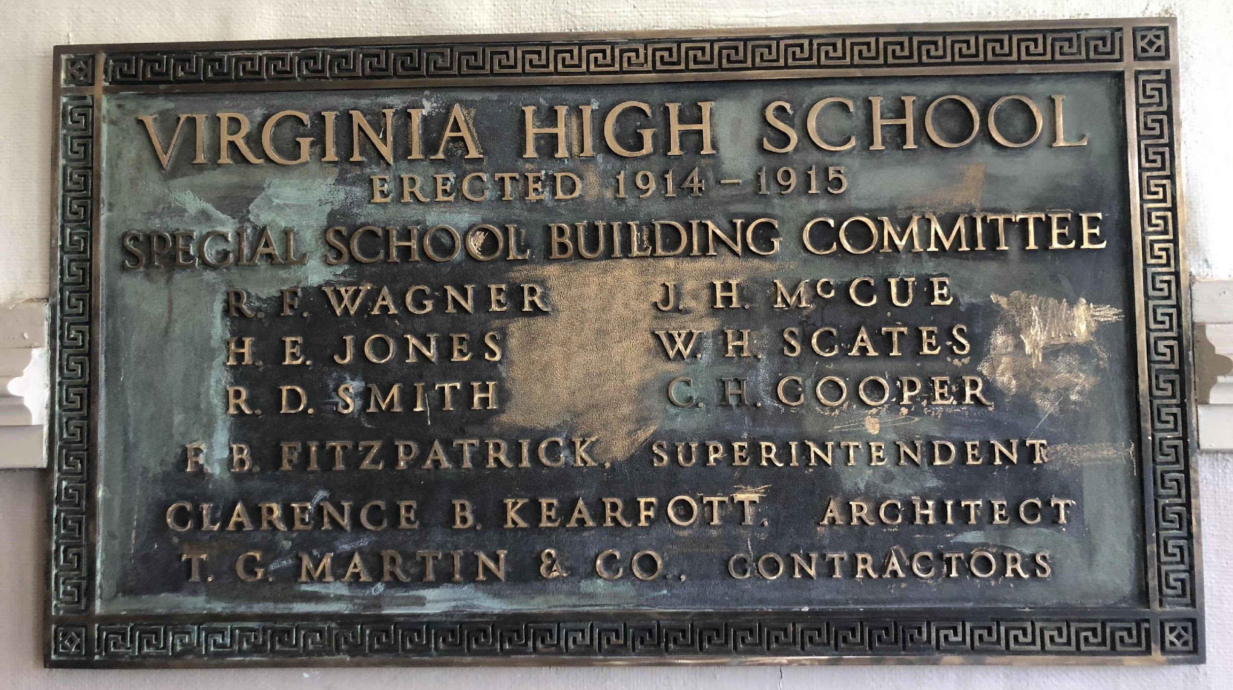
Notes:
Slide 12: With over half of Virginia’s schools over 50 years old–and many even older, the state now has an overdue bill of more than $25 billion to replace inadequate schools. This is not a problem unique to one part of the state – it is in all regions.

Slide 13
$25 billion needed for school construction
Virginia for the past 14 years left all the cost for school construction and renovation on the locality.
Note: 1-cent local tax increase: Arlington - $7,700,000 Norton - $23,000
Notes:
Slide 13: Virginia’s oldest school buildings are in our poorest districts. These districts cannot support bond referendums or repay loans for capital projects with their low incomes and tax bases. In Prince Edward County, replacing an elementary school where trash cans are strategically placed to catch roof leaks on rainy days would cost $39 million. That would require a 25.5% increase in the property tax in a county with a median household income of $44,253 (Yancey, 2022b).
Schools can apply to have a referendum on a 1 cent tax increase for schools, but in 2022, the General Assembly refused to allow Prince Edward to add this tax.
Until the new budget, the last time the state made school construction grants–not loans–available to localities was 2009.
The Literary Fund’s primary function supposedly was to provide low-interest loans to school districts for school construction. In the last five years, only $24 million of the Literary Fund went in loans to school construction while $790 million has gone toward teacher retirement.
The Virginia Department of Education has guidelines and standards for school facilities when old schools are renovated or new schools built, but these standards fall short of guaranteeing all students have adequate schools and classrooms. A locality must have the capacity to build or renovate to even consider the “recommendations” in these guidelines.

Slide 14
Let’s talk teacher salaries
Teacher salaries in Virginia were 10% below the national average.
VA ranked 25th in starting salaries in last national survey.
25% of Richmond teachers resigned at end of 2021-22 year. Why?

Slide 15
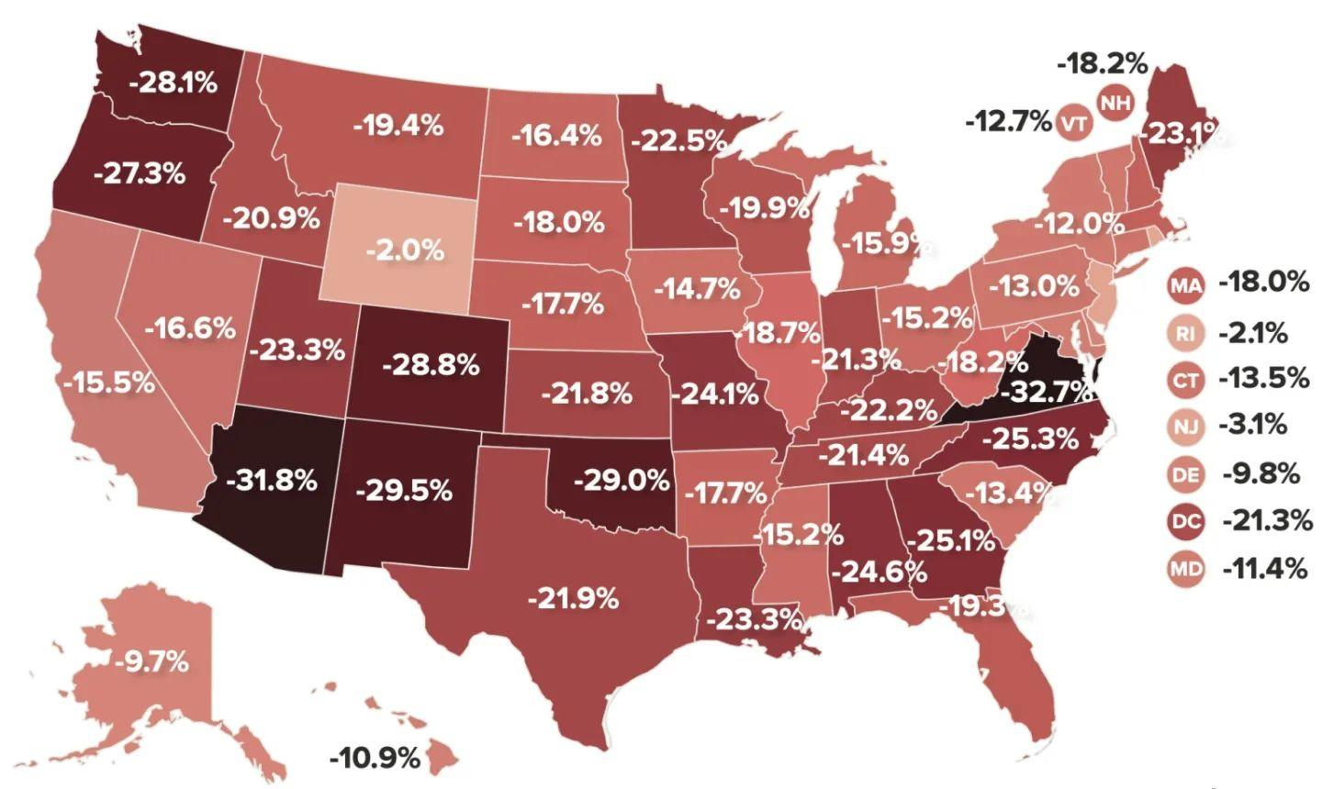
Teacher salary gap, compared to peers: 50th
TEACHER SALARIES
Notes:
Slide 15: Virginia ranks 25th nationwide in teacher starting pay; however, when you compare Virginia’s teacher salaries to those of comparably educated professionals, our state ranks 50th out of 50 states. Our teachers earn 32.7% less than their peers – the worst gap in the nation.

Slide 16
Latest budget
Virginia’s 2022-23 budget--with a $1.94 billion budget surplus:
School funding up by almost $3 billion
Teacher & staff raises of 5% - state pays less than half
$145 million for At-Risk Add-On program for high-poverty systems
$800 million for one-time construction grants
Literary Fund changes: $50 million for construction grants
$400 million for construction loans
Notes:
Slide 16: There is good news in the 2022-23 budget. We are fortunate that there was a large budget surplus, partly because of COVID money.
The state boasts 5% raises – but who really pays?? In a previous budget year, one county had to reject raises for its teachers because it could not afford its share.
The state is making some effort to balance need and capacity, but still leaves behind rural and city schools – where students in areas of poverty are likely to need more services and more expensive services if our state’s goal is equity in education.

Slide 17
What the General Assembly did not do
Leadership in both parties lacked the political will to develop long-term funding policies that guarantee high-quality education for all:
Failed to fully fund Standards of Quality as a minimum for a high-quality education
Reduced future tax revenues for state – putting future funding at risk

Slide 18
A key strategy for change
Amend the Virginia Constitution to state that the General Assembly shall provide rather than the current language of “shall seek to ensure an educational program of high quality.”

Slide 19
Strategies for operational funds
Fully fund the SOQ – which barely meet the criteria for a high-quality education; this burden on localities skews funding more.
Raise Virginia’s per-pupil investment to the average of other top ten income states ($4.3 billion/2021).
Increase teacher salaries to be comparable to salaries of those with comparable education.
Offer No-Loss funding.
Offer English Language Learner funding comparable to other states.
Notes:
Slide 19: No-loss funding means that localities don’t lose $$s when # of students declines.
Gov. Northam had proposed increasing staff % for ELL, but it was not included in the budget.

Slide 20
Strategies for infrastructure
Advocate for state commitment to fund school construction using grants and other mechanisms based on division’s ability to pay.
Increase and prioritize Literary Fund $$ for school infrastructure.
Make minimum building standards part of the SOQ.
Issue state bonds dedicated to school construction to address the $25 billion deficit.
Allow localities to impose a 1% sales tax for school construction, subject to voter approval.

Slide 21
Strategies for LWV-VA
The Virginia League of Women Voters should continue its efforts
to educate the public about the benefits of high-quality public education
to develop partnerships with other state organizations
to advocate actively for increased and more equitable school funding
and to improve the narratives that are told about our schools.
Notes:
One strategy suggested in our report is within the League’s control and, over time, could help develop the political will need to effect necessary change.

Slide 22
Again, we hope you had a chance to read the entire report, which gives a clearer and wider view of this complex issue.
Thank you!

