Slide 1
Notes for Teachers
The topic of the History of Voting Rights has been divided into two PowerPoint presentations due to length and size of files. Part 1 includes 1787 through 1920, and Part 2 includes 1924- Present Day.
A script to accompany this PowerPoint can be found in the notes section and in a separate Word document.
Consider using this PowerPoint in advance of studying voting rights to expand students’ background knowledge. It also could be used with specific students to reinforce information previously taught.
Encourage students to research:
Native American civil rights.
Aspects of the Civil Rights movement, such as the Freedom Rides, Bloody Sunday, March on Washington, Operation Breadbasket, women in the Civil Rights movement, and school desegregation.
The Civil Rights movement in Virginia, such as massive resistance (led by Senator Byrd encouraging ignoring the federate mandate to desegregate), school desegregation, voting rights, and marriage laws.
Gerrymandering and redistricting.
Issues around citizenship for people living in American Samoa. Why is this a debatable issue for Samoans?
Federal voting rights for people living in U.S. Territories.
Recommend reading John Lewis’ books, March: Book One, March: Book Two, and March: Book Three
Prompt students to develop voter registration and Get Out the Vote campaigns. .

Slide 2
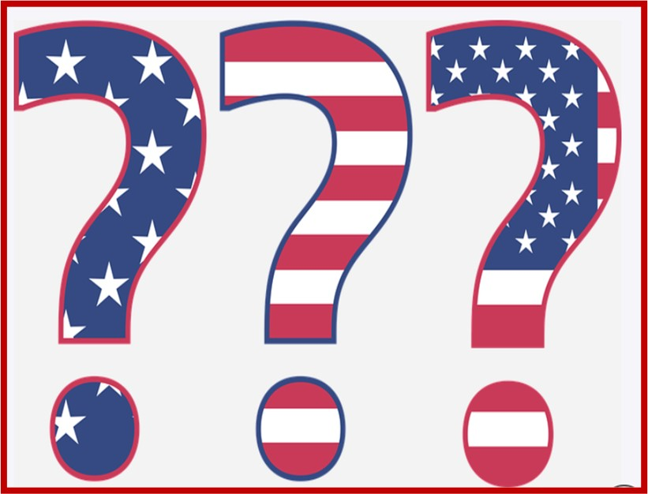
Who Can Vote?
A Short History of Voting Rights
1924 – Present (Part 2)
100 Year Mission To:
Empower Voters
Defend Democracy
Notes:
Who gets to participate in government? Who has a voice? Does “We the People” really mean ALL citizens? And who is considered a citizen?
This PowerPoint illustrates the expansion of voting rights in the United States and the importance of ensuring that all citizens have the right to vote.
Image: Question Answer Mark - Free vector graphic on Pixabay

Slide 3
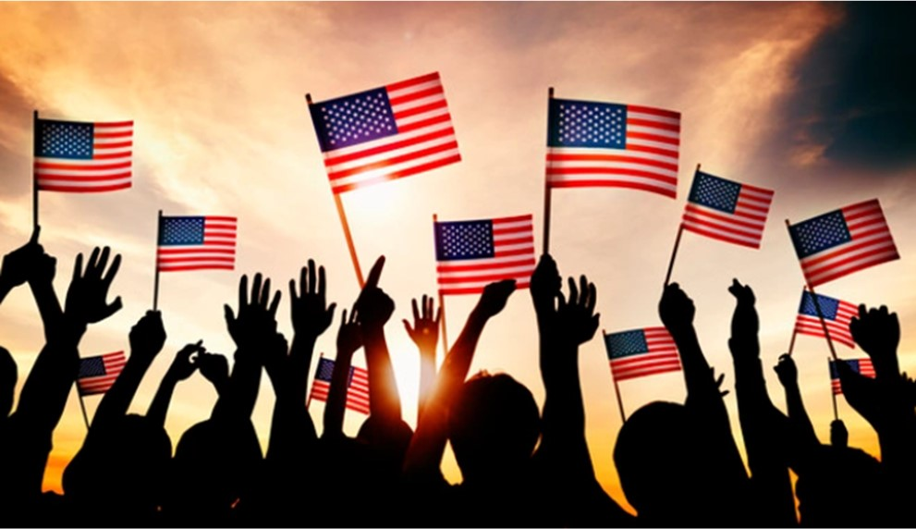
Who Could NOT Vote in 1920?
Black men and women, although technically they had the right to vote
Native Americans
Asian Americans
People under 21
More
Change Is
Needed!
Notes:
With passage of the 19th Amendment, more citizens were able to vote in 1920, but more change was needed as many could not vote. Although Black men and women had the right to vote, this right was suppressed in many states. Native Americans, Asian Americans, and people under age 21 still could not vote. This PowerPoint will share information about the rest of the story,
Image:
https://www.freepik.com/free-photo/group-people-waving-american-flags-back-lit_3533286.htm#page=5&query=united+states&position=41

Slide 4
What do you think?
 | True | False
Native Americans and Black Americans faced similar voting barriers.
The Civil Rights Movement caused major changes to voter registration and voting.
All citizens of the United States can vote for President.
All citizens of the United States can vote for a Senator or Representative to represent them in Congress.
Voting rights are now secure in the United States.
Notes:
Take a minute to read these sentences and decide if each one is true or false.
The first two sentences are true. Did you know that the last three sentences are false? View the information in this PowerPoint to find out more.

Slide 5
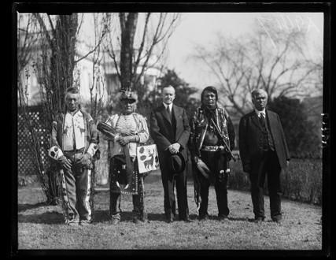
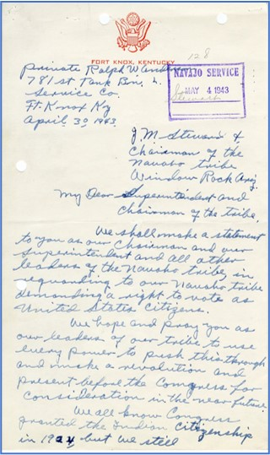
The Indian Citizenship Act (1924) gave citizenship to Native Americans.
Voting rights were often denied by states.
Letter from Jimmie King Navajo Code Talker, 1943
“We all know Congress granted the Indian citizenship in 1924, but we still have no privilege to vote. We do not understand what kind of citizenship you would call that.” (excerpt of letter from Jimmie King, Navajo Code Talker, 1943)
Notes:
Native Americans were denied American citizenship until 1924 when President Coolidge signed the Indian Citizenship Act. Even with the rights of citizenship, they were prevented from voting in many states because the Constitution allowed states to decide who could vote. Like other minorities, they faced barriers to voting such as poll taxes, literacy tests, and intimidation. In some states, Native Americans were not allowed to vote because they lived on tribal lands or reservations and did not pay property taxes. These discriminatory practices continued until 1965, but other voting barriers remain in place today, including having to travel long distances in order to vote and ballots and election materials that are not translated into native languages which many of the elders speak.
Image:
The War after the War: the American Indian Fight for the Vote after WWII – The Text Message (archives.gov)
Harris & Ewing, photographer. Calvin Coolidge and Native American group at White House, Washington, D.C. United States Washington D.C. District of Columbia Washington D.C, 1925. [January or February] Photograph. https://www.loc.gov/item/2016894067/. [Calvin Coolidge and Native American group at White House, Washington, D.C.] | Library of Congress (loc.gov)

Slide 6
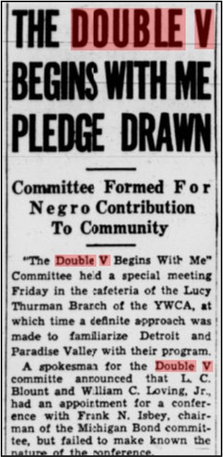
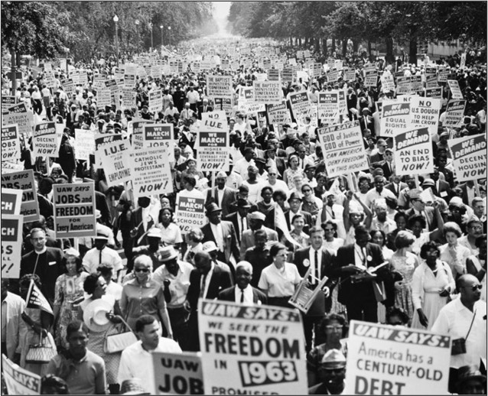
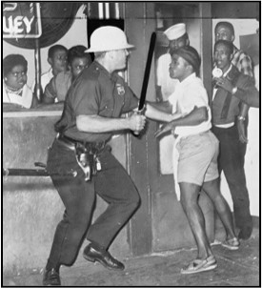
Civil Rights Movement
Notes:
During World War II, the African American double V campaign stood for victory in the war effort and victory over racial discrimination. Black men and women served in the war, but they still endured segregation and Jim Crow laws. The double V campaign focused on fighting for voting rights, equality in education, and equal opportunities for jobs at home. The double V campaign is viewed by many as the beginning of the Civil Rights movement. The struggle continued through the 1950s and 1960s. People bravely demonstrated, wrote letters to government officials, were beaten, attacked by police, jailed, marched, and held sit-ins at segregated lunch counters until government leaders realized that new laws were needed.
Additional information and resources about teaching the Civil Rights Movement can be found at https://www.tolerance.org/magazine/publications/the-march-continues/the-five-essential-practices-for-teaching-the-civil-3.
Images:
The Michigan chronicle. [volume] (Detroit, Mich.) 1936-current, July 31, 1943, Page PAGE THREE, Image 3 « Chronicling America « Library of Congress (loc.gov)
No known copyright restriction. For information see "New York World-Telegram & ...," http://www.loc.gov/rr/print/res/076_nyw.html
3. Samfunnsfaglig engelsk - The Civil Rights Movement - NDLA

Slide 7
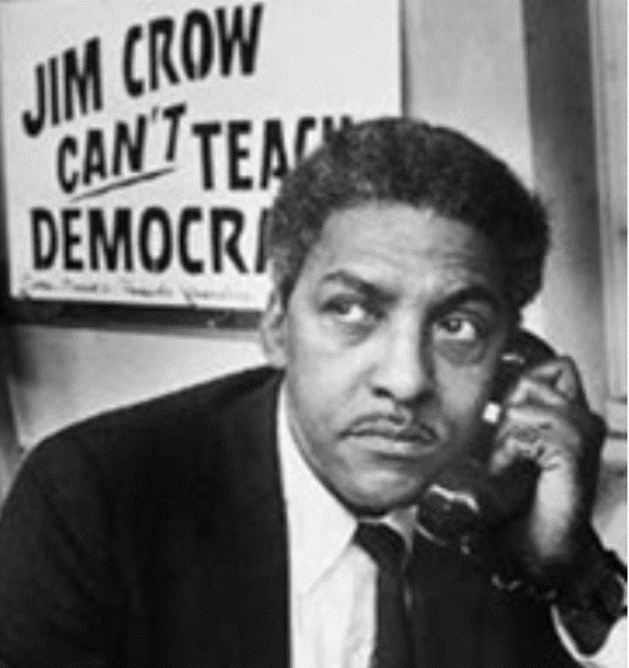
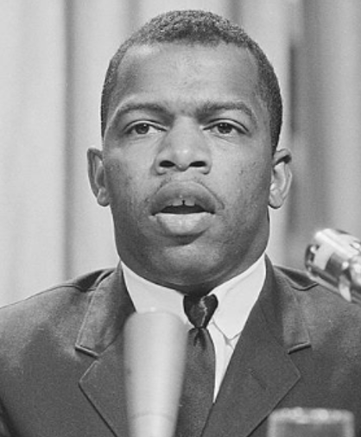
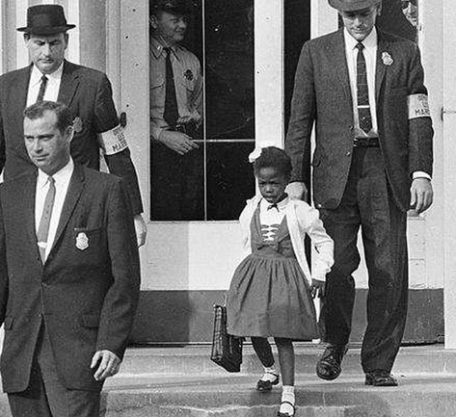
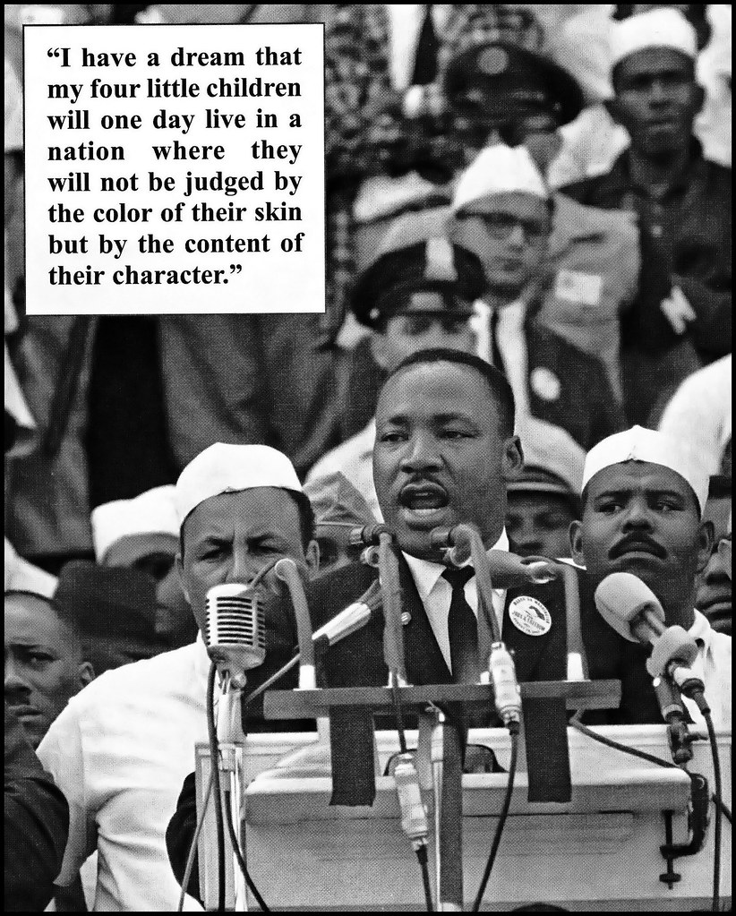
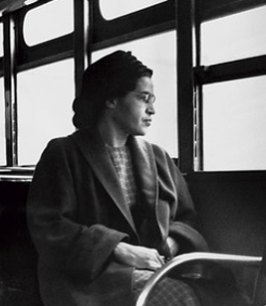
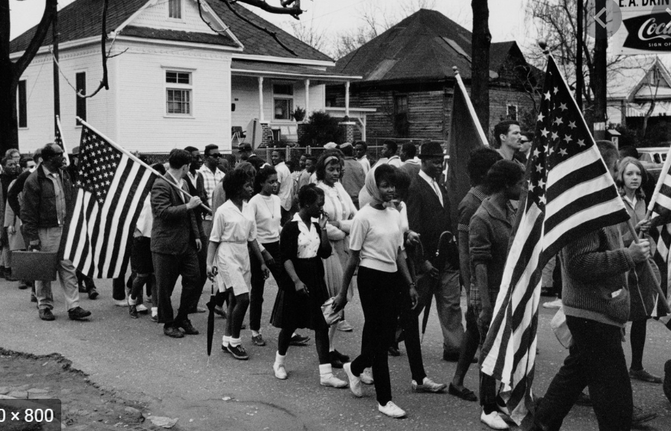
Many Faces of the Civil Rights Movement
Notes:
Many people were part of the Civil Rights Movement; Some have famous names and actions that we remember like Rosa Parks, John Lewis, Martin Luther King, Jr, and Jesse Jackson. Some were students who integrated schools, such as the young girl Ruby Bridges and the Little Rock Nine, but many, many more, whose names we do not know, were active in this fight. They were beaten, jailed, and sometimes killed for their willingness to advocate for African American rights as equal citizens.
Images:
The U.S. Civil Rights Movement" by U.S. Embassy The Hague is licensed under CC BY-ND 2.0
Pettus, Peter, photographer. Participants, some carrying American flags, marching in the civil rights march from Selma to Montgomery, Alabama in. Alabama Selma, 1999. [or 2000 from a Photograph Taken in 1965] Photograph. https://www.loc.gov/item/2003675345/.
Trikosko, Marion S, photographer. John Lewis speaking at a meeting of American Society of Newspaper Editors, Statler Hilton Hotel, Washington, D.C. / MST. Washington D.C, 1964. Photograph. https://www.loc.gov/item/2003688130/.
Rosa Parks defies segregation on Alabama bus" by Chris Green is licensed under CC BY-NC-SA 2.0
Bayard Rustin - Civil Rights (U.S. National Park Service) (nps.gov)
"'I Have a Dream'" by Tony Fischer Photography is licensed under CC BY 2.0

Slide 8
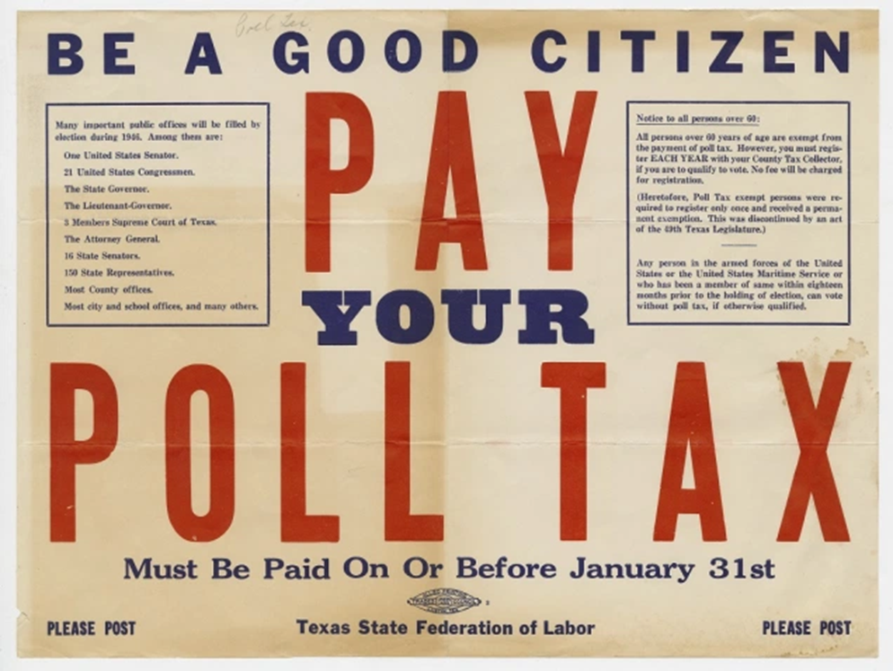
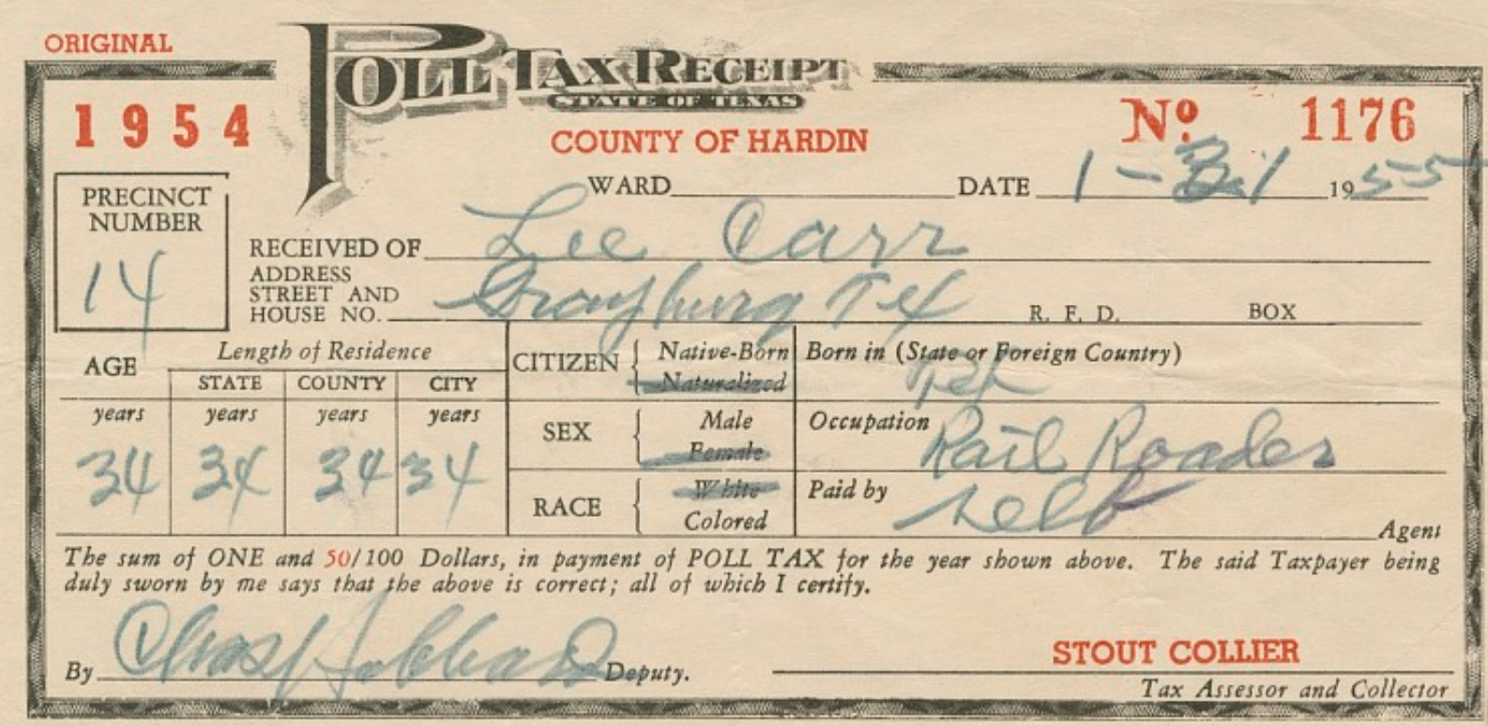
The 24th Amendment (1964) ended
poll taxes in federal elections.
Notes:
The 1960s and early 1970s were years of turmoil and change in the United States. President Kennedy was assassinated, the Vietnam War was raging, and protesters were demonstrating. The struggle for equal rights culminated in federal action during the 1960s. The 24th amendment finally stopped all states from imposing taxes on voting in federal elections. However, five states, Alabama, Arkansas, Mississippi, Texas, and Virginia, continued to assess poll taxes until 1966 when state poll taxes were declared unconstitutional by the Supreme Court. As a result, people cannot be taxed or required to pay money in any form in order to vote.
Images:
RG99-001.8.FD1/F/1.397, Be A Good Citizen, Pay Your Poll Tax, 1946, Folder: FD1/F/1, item: 397. Labor Posters, Broadsides, and Art collection, 0095-LBR-RG99-001. Special Collections and University Archives. https://archives.lib.umd.edu//repositories/2/archival_objects/449521
https://www.si.edu/object/poll-tax-receipt-lee-carr-hardin-county-texas:nmaahc_2012.104

Slide 9
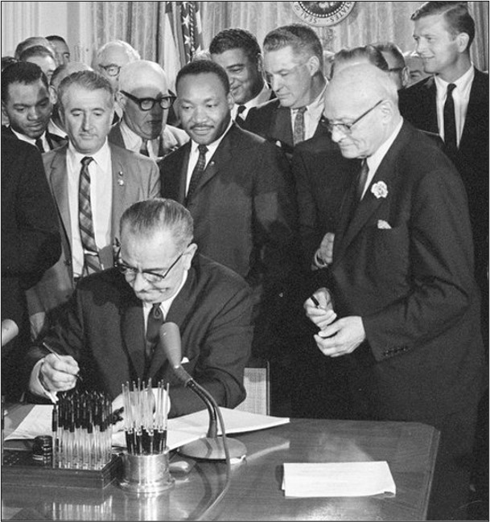
The Civil Rights Act of 1964 was passed to end discrimination based on race, color, religion, and national origin.
Notes:
The Civil Rights act was proposed by President Kennedy, but it was not passed before his assassination. President Johnson lobbied for its passage and signed the law in 1964 as part of his Great Society program. This law guaranteed equal access to public facilities, such as restaurants, buses, and hotels. It also ended segregation in education and provided federal protection of voting rights.
Images:
LBJ Library photo by Cecil Stoughton LBJ Presidential Library | Research (lbjlibrary.net) 276-10-WH64

Slide 10
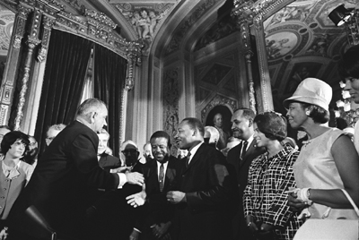
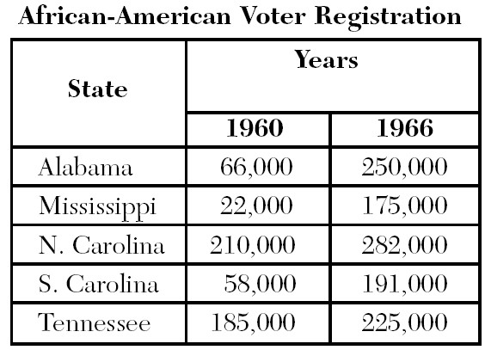
The Voting Rights Act of 1965 ended literacy tests and other restrictions on minority voting rights in state and local elections.
Notes:
The Civil Rights march from Selma to Montgomery Alabama was a significant event that led to the passage of the Voting Rights Act. The first march led by John Lewis was stopped by state troopers who beat the unresisting marchers and is known as “Bloody Sunday.” This jolted the conscience of the nation, and President Johnson called for a voting rights bill. Two weeks later, with federal troops protecting the route, a crowd of thousands led by Martin Luther King successfully marched to Montgomery.
The Voting Rights Act prohibited racial discrimination in voting including ending literacy tests in state and local elections.
If a jurisdiction had a significant language minority population, this law also required election material in languages other than English. The Voting Right Act has been renewed several times, most recently in 2006 for 25 years.
Look at the chart. You can see the difference the 24th Amendment, the Civil Rights Act of 1964, and the Voting Right Act of 1965 made by noticing how voter registration increased for African American citizens from 1960 to 1966.
Images:
LBJ Presidential Library | Research (lbjlibrary.net) A1030-17a
Chart created by NAACP Legal Defense Fund, Used with Permission

Slide 11
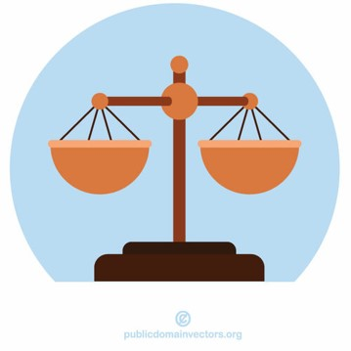
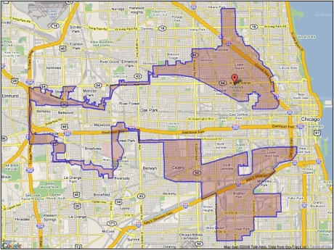
One Person, One Vote
Gerrymandering:
Congressional districts that create an unfair advantage for a political party
Voting Districts with
Balanced Representation
of Voters
Notes:
During this same time, the U.S. Supreme Court ruled on several cases to establish the concept of “one person, one vote.” (Reynolds v. Sims [1964]) In other words, every vote must have the same value, and voting districts for both the U.S. House of Representatives and state legislators must be roughly equal in population. In 1983, the Supreme Court ruled that creating voting districts with almost equal populations was not sufficient, and states must also create voting districts using consistent, nondiscriminatory policies (Karcher v. Daggett). This ruling was reinforced by subsequent cases that established the principal that racial groups should not be over- or under-represented in voting districts.
Another type of unfair voting districts, or gerrymandering, occurs when state legislators create voting districts that favor one political party over another. The Supreme Court has not yet addressed this issue.
Images;
Scales of justice | Public domain vectors
"illinois-4th-district-map-gerrymandering" by SBTL1 is marked with CC PDM 1.0

Slide 12
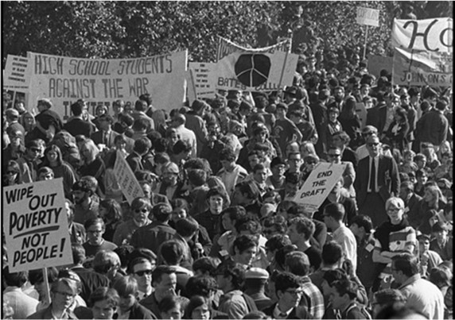
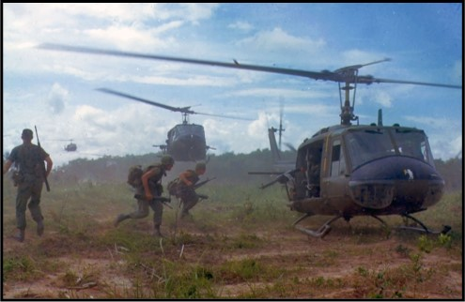
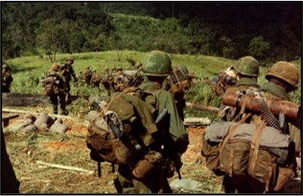
The 26th Amendment (1971) lowered the voting age to 18.
Catalysts for Change
War Protests
Vietnam War
Notes:
The first push to lower the voting age came during World War II when the military draft was lowered to include 18-year-olds. People horrified by the idea that men could be sent to die for their country before being old enough to vote coined the slogan: "Old Enough to Fight, Old Enough to Vote." However, the effort to lower the voting age to 18 was not successful at that time.
The idea to lower the voting age to 18 rose again during the Vietnam War era. Senator Edward Kennedy raised the issue using the same slogan, “…—old enough to fight, old enough to vote.” Then Senator Kennedy added, “About 30 percent of our forces in Vietnam are under 21. Over 19,000, or almost half, of those who have died in action there were under 21. Can we really maintain that these young men did not deserve the right to vote?"
In 1971, the 26th Amendment granted 18-year-old citizens the right to vote. The Vietnam War ended in 1975 when the US withdrew its troops from Vietnam.
Images:
[Large crowd at a National Mobilization to End the War in Vietnam direct action demonstration, Washington, D.C.] / WKL. | Library of Congress (loc.gov)
Military Vietnam War Soldiers - Free photo on Pixabay
File:8th Infantry Rgt. descending Hill 742 during Operation MacArthur 1967-11.jpg - Wikimedia Commons

Slide 13
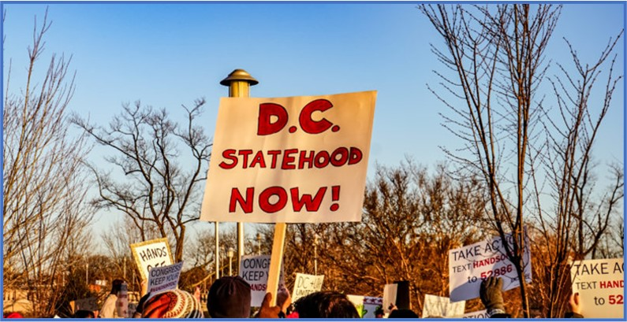
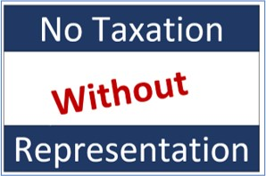
The 23rd Amendment (1961) allowed citizens in the District of Columbia to vote for President.
Notes:
The District of Columbia is not a state. As a result, District residents do not have the same voting rights as many other citizens even though there are more residents in Washington, DC than in the state of Wyoming. They did not gain the right to vote for President until 1961. They still cannot elect a voting member of Congress, although they can elect a non-voting member of the House of Representatives who can speak on issues and urge others to pass laws on their behalf. You may have seen their license plates reviving the slogan, “Taxation Without Representation,” that was first used during the War of Independence with Great Britain. They are lobbying to become the 51st state so they will have the full voting rights of a citizen living elsewhere in the United States.
Images:
Bumper Sticker, D.C. Voting Rights | National Museum of American History (si.edu) District of Columbia League of Women Voters
Graphic by League of Women Voters of Fairfax Area, Microsoft Word
Puerto Rico 51st Congress to Vote on D.C. Statehood (pr51st.com) Creative Commons

Slide 14
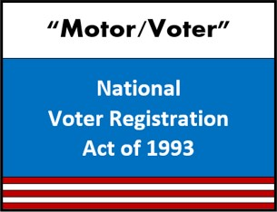
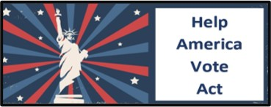
National Voter Registration Act (1993)
Changes to Voting Continue . . .
Voting Accessibility for the Elderly and Handicapped Act (1984)
The Uniformed and Overseas Citizen Absentee Voting Act (1986)
Help America Vote Act (2002)
Notes:
Improving access to voting continues.
The Voting Accessibility for the Elderly and Handicapped Act required accessible polling places in federal elections for elderly individuals and people with disabilities who might not be able to walk into a polling place.
The Uniformed and Overseas Citizen Absentee Voting Act granted military and citizens living abroad the right to vote in federal elections.
National Voter Registration Act required states to permit voter registration by mail and make voter registration available at the DMV.
Help America Vote Act created required minimal standards for voting procedures, including upgrading voting machines, registration processes, and poll worker training.
Think about how some of these groups were kept from voting in the past. Through no fault of their own, they often did not have the opportunity to vote.
Images:
1 -3 League of Women Voters of the Fairfax Area, Microsoft Word
4. Free Vector | Fourth of july banners (freepik.com) Words added by League of Women Voters of the Fairfax Area, Microsoft Word

Slide 15
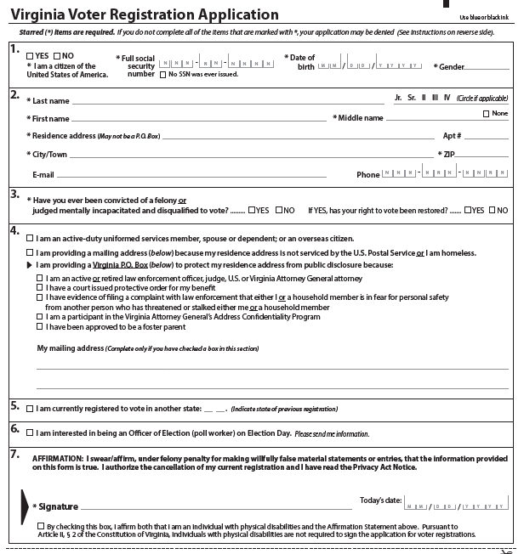
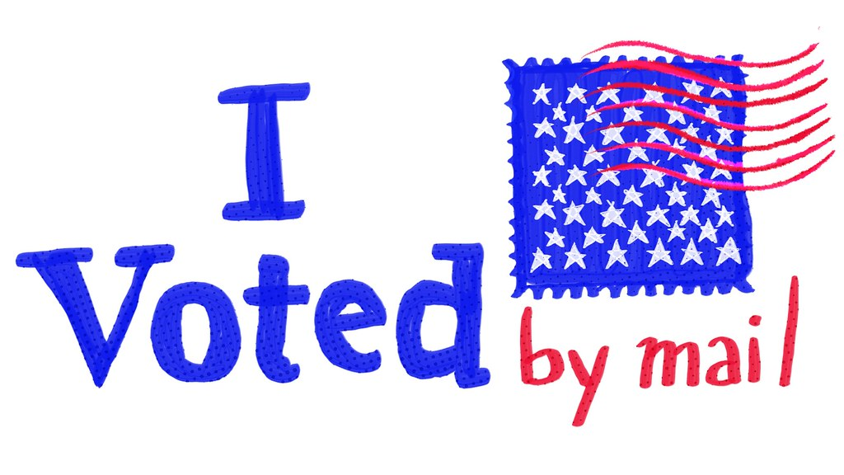
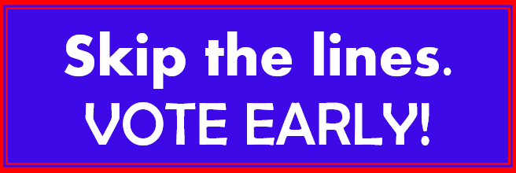
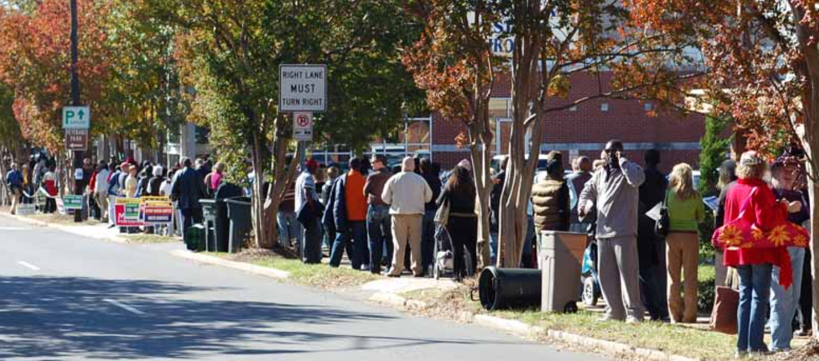
States influence who votes by making it easier or harder to cast a ballot.
Voting Options
= More Voting
Access to Voter Registration = More Voters
Few or Inconvenient Polling Places = Fewer Voters or Long Lines & Discouraged Voters
Notes:
Remember, states can make decisions about voter registration and voting procedures. Statistics show that when states offer more options for voting, such as voting by mail or voting early, in addition to in-person voting on election day, more people will vote.
When states provide more access to voter registration, such as allowing both registering online and registering with a paper application, more people can become voters. The requirements for voter registration are also important. Many Native Americans who live on rural reservations or tribal lands do not have street addresses which are required for voter registration in some states. The requirement of a street address limits their ability to register.
The location and number of polling places are important issues. When there are few or inconvenient polling places, people need to travel long distances to vote or may need to wait in long lines. Not everyone can do this because of their circumstances, such as their work schedule or not being able to access transportation. This discourages people and results in fewer voters.
Images:
"Vote by Mail" by Timothy Valentine is licensed under CC BY-NC-SA 2.0
League of Women Voters of the Fairfax Area, Microsoft Word graphic
Man Using Computer - Free photo on Pixabay
File:2008 Presidential election early voting lines, Charlotte (2989096149).jpg - Wikimedia Commons

Slide 16
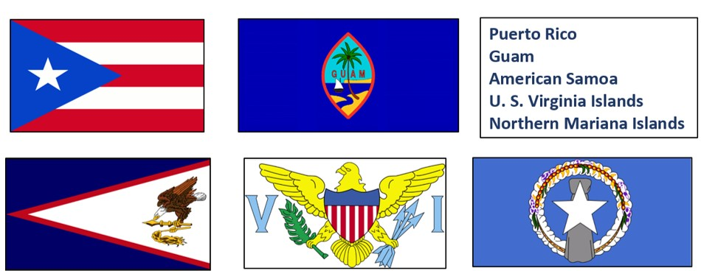
No Federal Voting Rights for People in U.S. Territories
We
cannot
vote!
Notes:
Northern Mariana Islands, Puerto Rico, Guam, American Samoa, and U.S. Virginia Islands are part of the United States, but they are territories, not states. People who live in these territories are citizens with one exception. The people who live in American Samoa are U.S. nationals, not citizens. The people who live in these territories can vote only in their own local elections. They cannot vote for President or for a voting member of the House of Representatives. Like the District of Columbia, each territory can elect only a non-voting member of the House of Representatives, who can advocate for them. (Residents of these territories pay U.S. taxes such as social security and Medicare, but they do not pay federal income taxes. The territory may impose a territory income tax much like the states have a state income tax.)
Do you think it is fair that these territories cannot vote in U.S. federal elections? This is a topic that you might want to research further.
Images:
File:Flag of Puerto Rico.png - Wikimedia Commons
File:Flag of Guam 1934.gif - Wikipedia
640px-Flag_of_American_Samoa.svg.png (640×320) (wikimedia.org)
Flag of US Virgin Islands - United States - Openclipart
Flag of Northern Mariana Islands - Openclipart

Slide 17
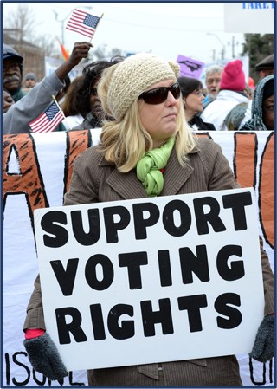
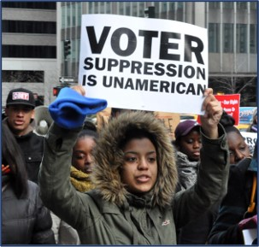
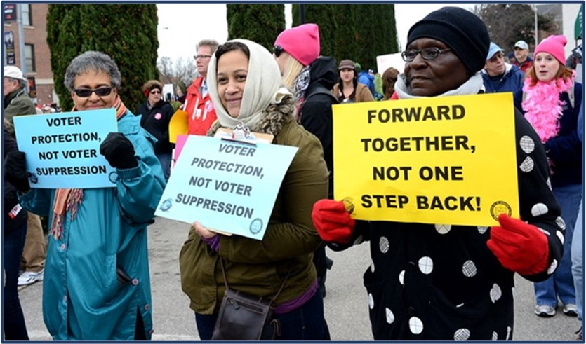
Who Can Vote?
Protect
the right to
VOTE!
Notes:
President George W. Bush said, “A great nation does not hide its history; it faces its flaws and corrects them.” That’s why the answer to the question, “Who can vote?” has changed many times since the U.S. Constitution was first written. Our democracy can only be sustained and improved by using our voting rights and protecting voting rights for all citizens. All of us must work to ensure that every citizen can vote without barriers, without difficulty and without fear so their voice can be heard.
Images:
"February 2014 Moral March On Raleigh 32" by Stephen D. Melkisethian is licensed under CC BY-NC-ND 2.0
December 10 march for voting rights" by Michael Fleshman is licensed under CC BY-SA 2.0
"February 2014 Moral March On Raleigh 32" by Stephen D. Melkisethian is licensed under CC BY-NC-ND 2.0

