Slide 1
Teacher Notes
Be sure to notify parents ahead of time that you are offering the opportunity to register to vote as required by state law.
Emphasize that students must be 18 by the next November general election, usually held on the first Tuesday after the first Monday in November, in order to register and vote. Students who are 16 or 17 but will not be 18 by the November general election can pre-register.
Be sure to state that only U.S. citizens can register. (Having a green card is NOT the same as citizenship.)
Remind the students at least a week in advance, and daily after that they will need to have their Social Security number AND the number on their driver’s license, learner’s permit, or Virginia ID issued by the Virginia DMV in order to register online. If they don’t have an ID issued by the DMV, they must use a paper application.
Send students an email with the registration link when you get to slide 9. You could send the link below and ask students to scroll to the correct school OR send them the specific link for your school found on this webpage. Using the unique school link gives your school credit for the number of students registering to vote.
https://www.lwv-fairfax.org/hsvr

Slide 2
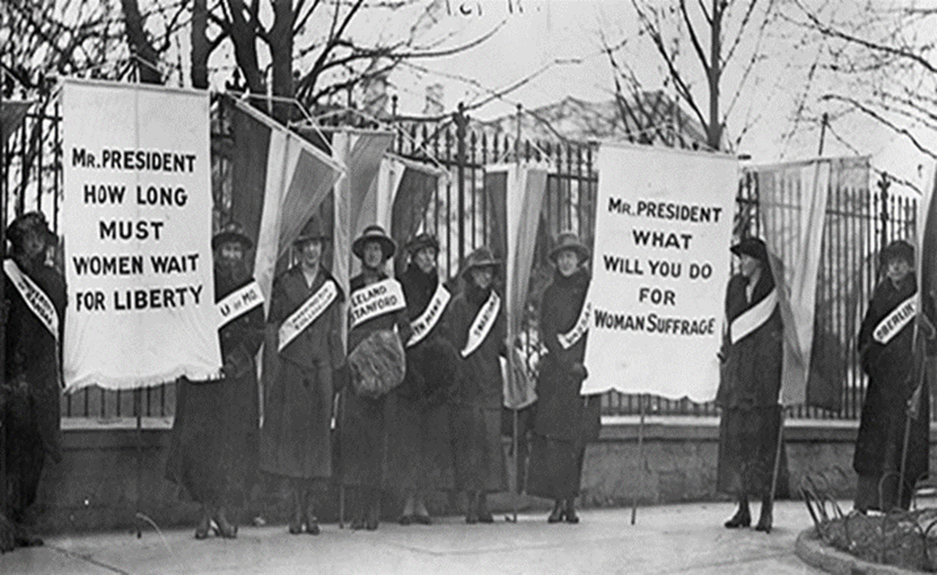
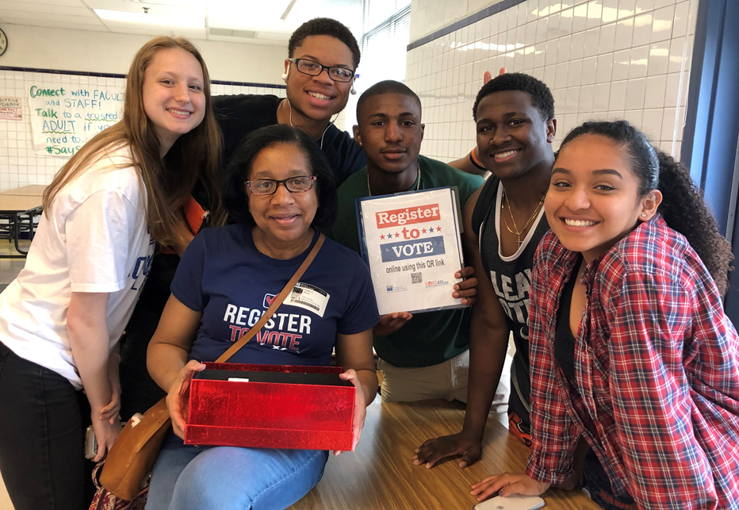
104 Year Mission To:
Empower Voters
Defend Democracy
Then
Now
Notes:
Welcome to this presentation by the League of Women Voters. In 1920, after years of advocating for the right to vote, the 19th amendment was passed. This gave women the right to vote. At that same time, the League of Women Voters was established to assist people to register to vote and provide nonpartisan information so that people could become educated voters. This is still true of our mission today.
The goal of this presentation is to provide a short introduction about the history of voting rights and help you register to vote in Virginia using the online application. If you want/need to register with a paper application, view the presentation that explains completing the paper voter registration application form. Additional presentations in this series address other aspects of voting.
Image sources:
(1917) The first picket line - College day in the picket line. Washington D.C, 1917. Feb. [Photograph] Retrieved from the Library of Congress, https://www.loc.gov/item/97500299/.)
LWV-FX photo

Slide 3
Women’s Suffrage
1919
19th Amendment
Civil Rights Act
1964
Voting Rights Act
1965
Struggle for voting
rights
1960s
Voting age lowered to 18
26th Amendment
1971
Notes:
Top photos:
When the United States was founded, only white men who were 21 years old or older and property owners could vote. While the first women’s rights convention was held in 1848 at Seneca Falls, after the Civil War, women began advocating for the right to vote once again. Here you see a picture of women participating in a protest rally . Women protested at the White House for the first time and even chained themselves to the fence there. Under the direction of President Wilson, the women were arrested and jailed at the federal prison in what is now the Lorton Workhouse. While there, the women continued their protests and were even force fed. There is a small museum called the Lucy Burn Museum, there now that documents what took place.
Middle photos:
While Blacks were given the right to vote in 1870 by the 14th and 15th Amendments, they were effectively kept away from the polls by Jim Crow laws such as poll taxes and literacy texts until the 1960s. The Civil Rights Movement began after WWII when Black soldiers who had fought for freedom oversees came home only to face discrimination here. There were many leaders within the Civil Rights Movement who led protests to increase voting rights. One of them was John Lewis who was beaten and arrested more than 25 times in his efforts to promote voter registration. This work culminated in the Civil Rights Act of 1964 and the Voting Rights Act of 1965. s
Bottom photos:
During the 1960s, the United States was involved in a war in Southeast Asia. The Vietnam War required many soldiers which resulted in the establishment of a draft that required all males to register for the draft when they turned 18 years old. Many of these young men who were drafted died or were injured in the war. As media coverage of the war showed the devastation, young people began to protest the war and the draft. “Old enough to fight, old enough to vote” became the driving message that resulted in the 26th Amendment which gave young people, age 18-21 the right to vote.
s
Image Sources:

Slide 4
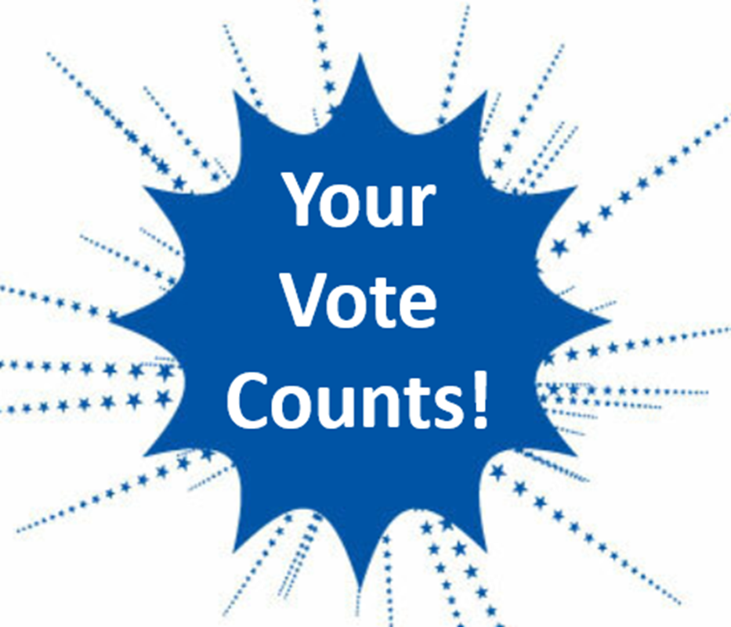
Vote to:
Voice your opinion.
Impact our government.
Elect our leaders.
If you don’t vote, who speaks for you?
Notes:
Why is it important to vote? It is the best way to make your opinions heard, influence government decisions, and elect people who support your views. If you don’t vote, you are giving up your right to impact your government to those who do vote.
Images
https://publicdomainvectors.org/en/free-clipart/Bursting-stars-with-empty-sticker/3274.html (words added)
Red text box created by Microsoft Word

Slide 5
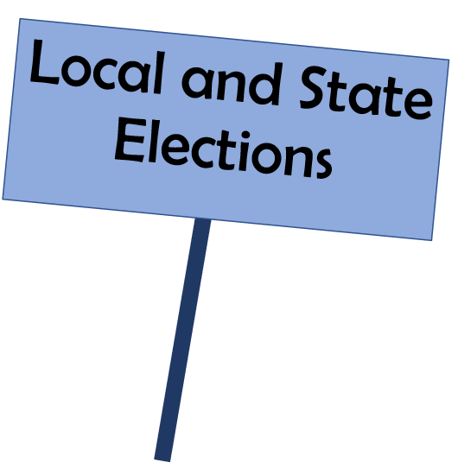
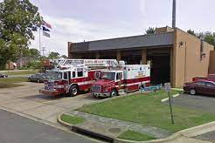
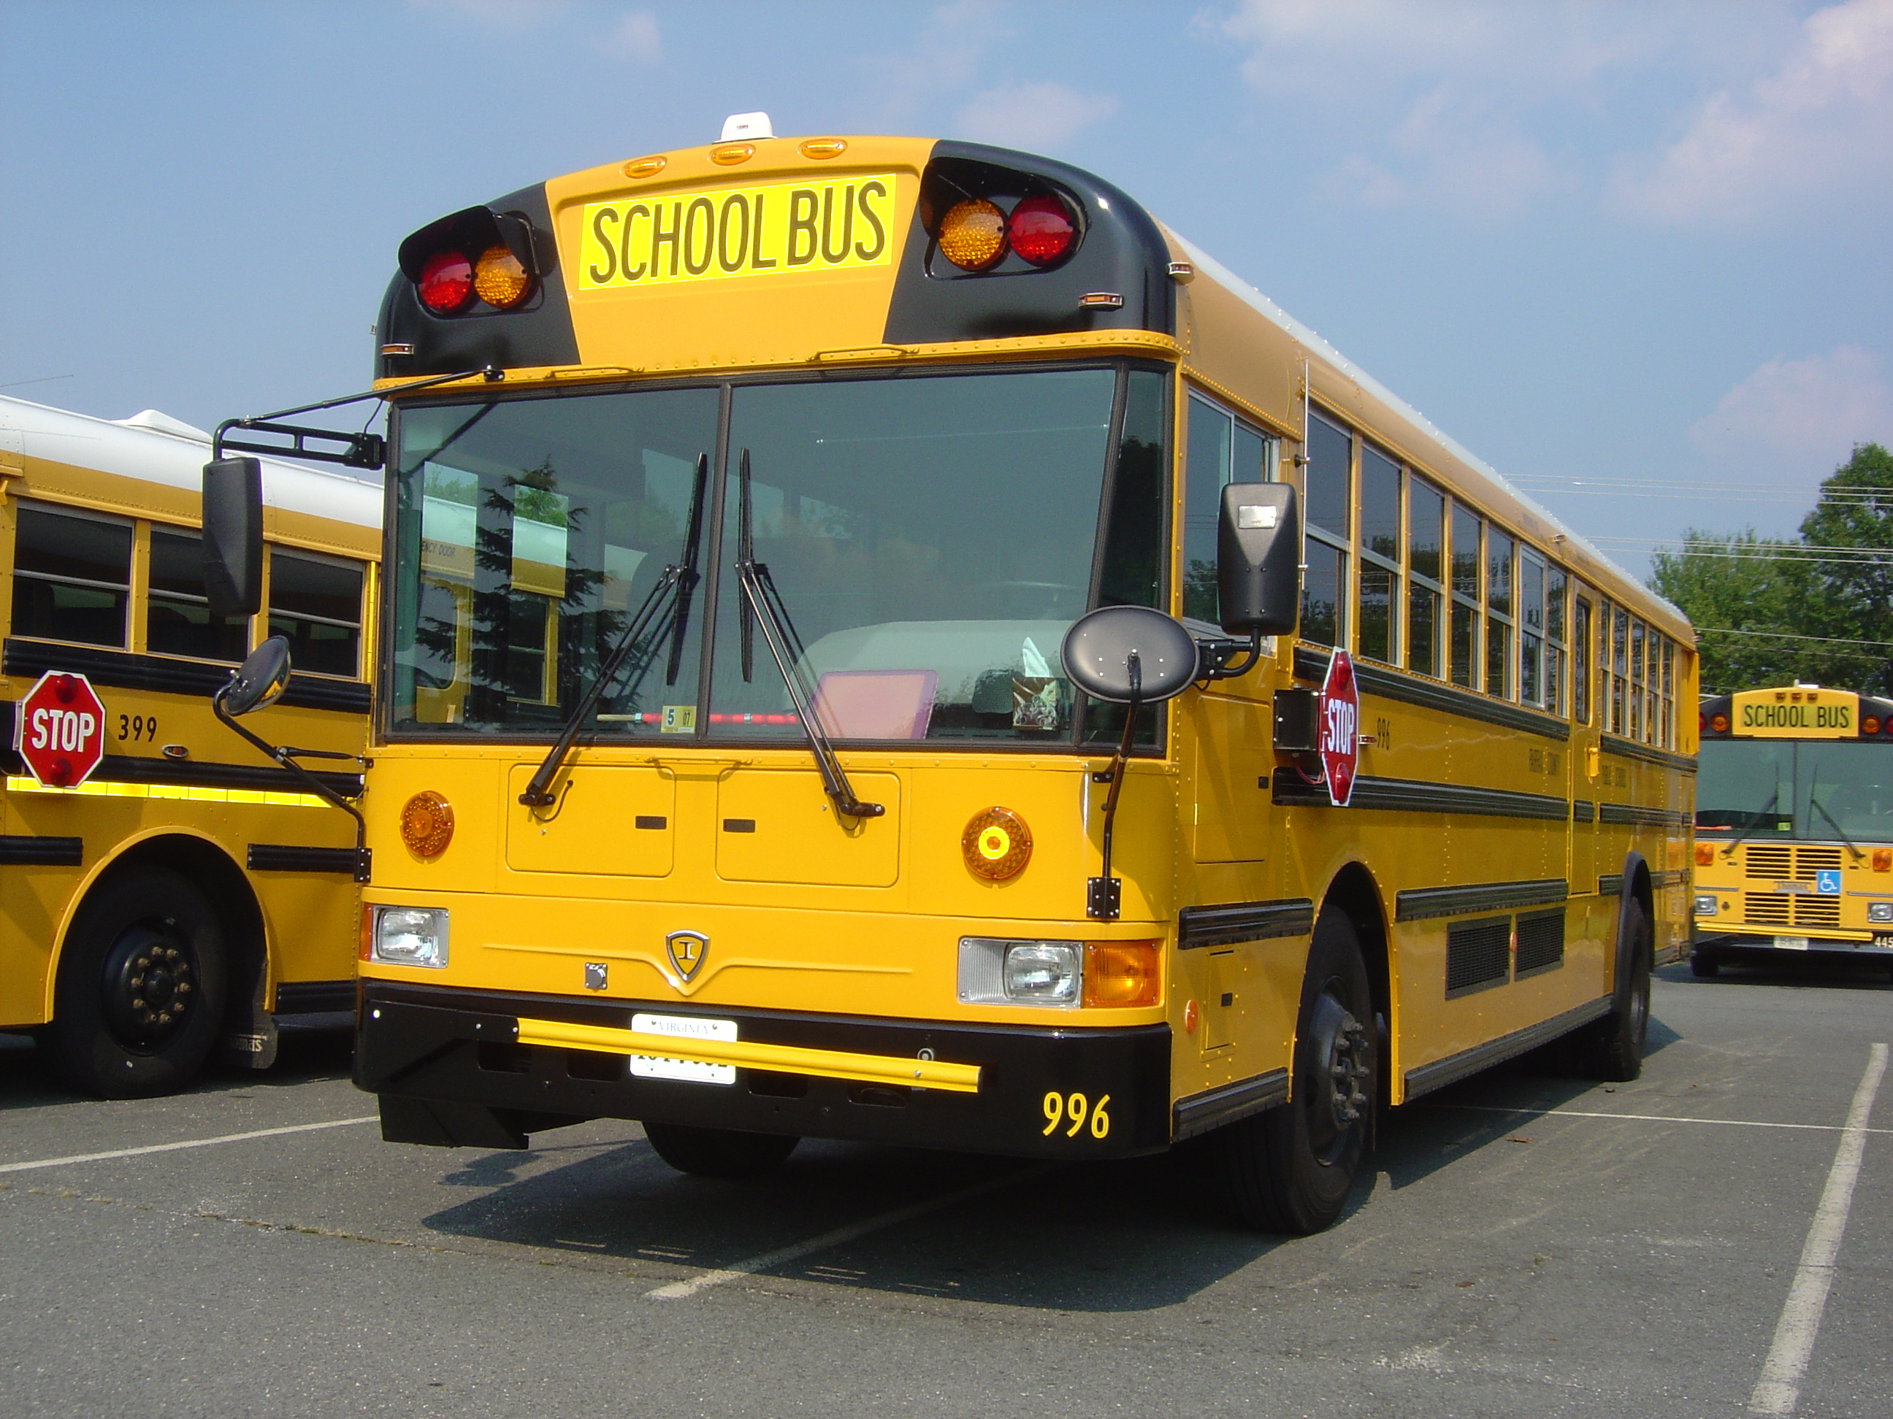
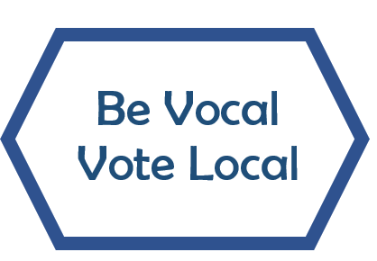
Every Election Matters!
State and local government directly affect your daily life. State and local elected officials make decisions about:
Taxes/ how tax money is spent.
Police and public safety.
Schools and education issues.
Roads, public transportation.
Parks, Rec-Centers, libraries.
Public libraries.
Environmental issues.
Rules about voting.
Notes:
Not only does every vote matter; every election also matters. In Virginia, there are elections held every year!
Often people are only interested in presidential elections that occur once in every four years and get lots of media attention. As a result, fewer people vote in state and local elections.
However, state and local elections are very important, maybe more important, because these results MOST directly affect your daily life. You can have the most influence in these state and local elections due to the total number of votes cast for these offices. You can also contact these officials directly to communicate your concerns or ask questions.
For example, the results of these elections impact the amount of state and local taxes people pay and how that tax money is spent.
The people elected make decisions about what you study in school, graduation requirements, and what roads to fix or build, The same for school buildings, public libraries, parks, and recreation facilities. They also influence policing, public safety, the environment, and the local rules about voting.
Think about what issues are important to you? Are these the same issues as your parents and grandparents? If you want YOUR voice to be heard about these issues, YOU must vote in state and local elections.
Images
Picture of fire station obtained from FXX Now (via Google Maps).
Picture of water park at Cub Run Rec Center obtained via Facebook.
Bus picture has been released into the public domain by its author, IC-RE at English Wikipedia.

Slide 6
Parents in the Military?
Ask them for advice about where you should register, in Virginia or your home state.
To find out about registering in your home state:
Go to vote411.org
Click on register to vote
Enter your Zip Code
Information about registering in a different state will appear
Notes:
If you are from a military family, check with your parents. They may want you to register in their “home of record” state rather than here in Virginia. If so, go to Vote 411.org, click on register to vote to find Information about how to register in another state

Slide 7
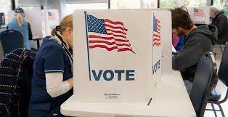
Who can register and vote?
Who can pre-register?
Who can pre-register?
Virginia resident
U.S. Citizen
18 on or before November 7, 2023
Virginia resident
U.S. Citizen
Aged 16 or 17 now, but won’t be 18 before November 7, 2023
*Students who pre-register will receive notification when they are eligible to vote.
Notes:
If you decide to register to vote, you must be a Virginia resident, and you must be a US citizen. If you are 17 today but will be 18 by the next November general election which is the first Tuesday in November, you can register and vote in the upcoming election.
If you will NOT be 18 by the next November Election Day but are 16 or 17, you can preregister. The process is the same and you need to complete the same form. However, once the completed online form is submitted, the Office of Elections will keep the pre-registration application on file and you will be notified when you are age eligible as to where you need to go to vote. Please remember that if you pre-register, that means you are NOT eligible to vote until notified you are eligible.
Image source:
Image obtained from Fairfax County Government website - https://www.fairfaxcounty.gov/news/fairfax-county-send-letter-correct-states-inaccurate-voter-mailing

Slide 8
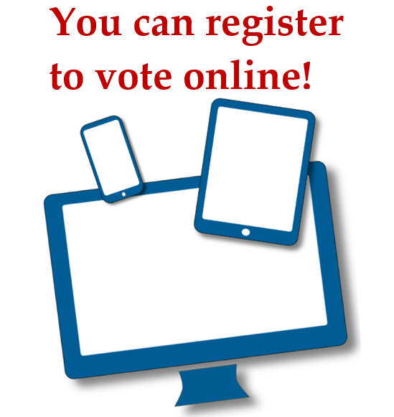
To register online, you need the number on your driver’s license, learner’s permit, or a Virginia ID from the DMV and Social Security #.
Click on the link you received
OR
Go to: https://www.lwv-fairfax.org/hsvr
Scroll down and click on your school’s name.
This will bring you to the “Citizen Portal”.
Notes:
If you have a Virginia driver’s license, learner’s permit, or an ID from the Virginia DMV, you can register to vote online. You will need the “customer identifier number” from one of these documents. If you do not have one of these IDs from the Virginia DMV, you cannot register online and must use a paper application instead. It is very important that the online form is completed correctly so the application will be approved, and you will be registered to vote.
Register online using the link for your school. You could get this link from your teacher or click on the link on the slide and scroll down to find your school.
Image source:
https://pixabay.com/vectors/media-laptop-tablet-pc-smartphone-774068/

Slide 9
This is the “Citizen Portal” on the official site of the Virginia Department of Elections.
Click on to continue.
Notes:
When you click on your school link, you will come to the “Citizen Portal” on the official website of the Virginia Department of Elections. As you can see, you can also do other things related to voting using this website. It is helpful to check your voting status and polling place before each election to minimize any issues when you go to vote.
Click on “Register to Vote” to continue .

Slide 10
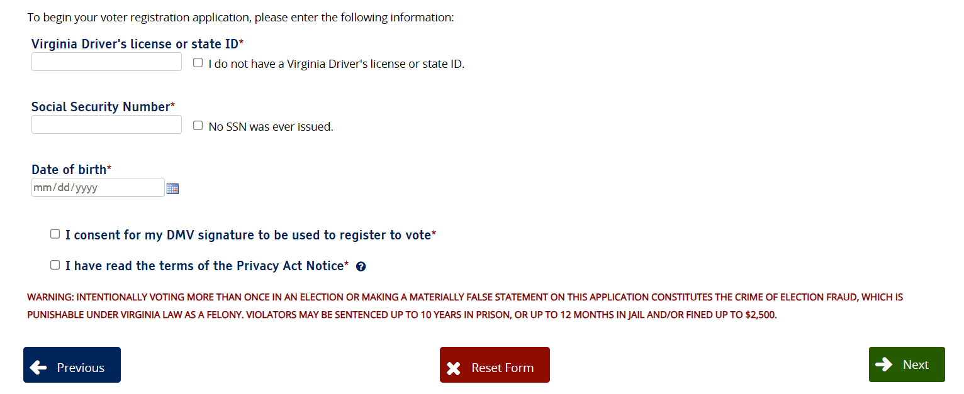
Enter the Customer Identifier number on your Driver’s license, learner’s permit, or DMV ID, and your Social Security Number.
Use the calendar to enter your date of birth.
You MUST check both boxes to agree that the information from the DMV can be used for your voter registration and that you have clicked on the question mark and read the privacy act information.
Click Next at the bottom of each screen to continue.
If you receive an error message as you enter information, it means that the information does not match the DMV records.
Notes:
On this screen, accurately enter the number on your driver’s license (Customer identification number on your DMV ID), your Social Security number and your date of birth.
You must click the boxes below your date of birth that indicates you are providing your own accurate information and not another person’s.
You are also agreeing that the information from the DMV can be used for your voter registration.
When finished entering your information, click the “Next” button to continue.
Image: Virginia Department of Elections

Slide 11
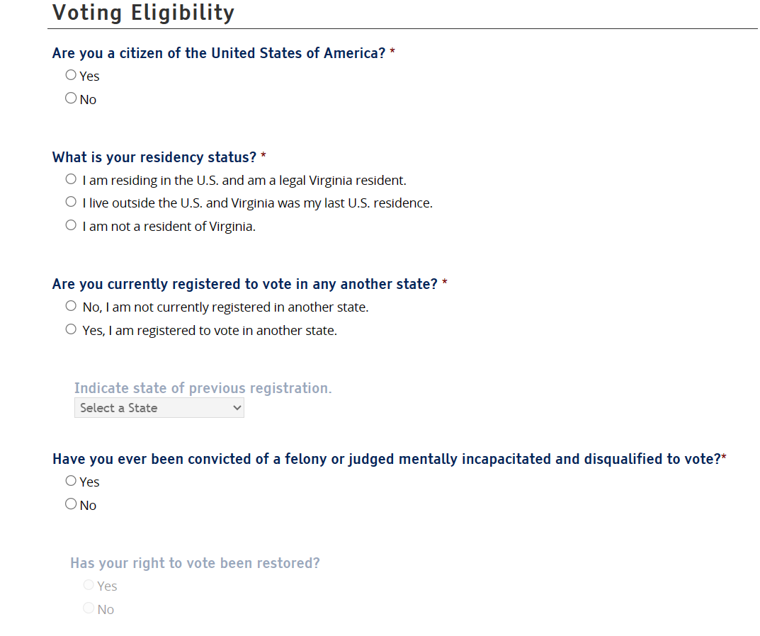
Indicate the correct answers by clicking the buttons.
If you answer that you are registered to vote in another state, you must type the name of that state in the box.
If you were convicted of a felony or were judged mentally incapacitated, you must indicate that your right to vote has been restored.
Notes:
Continue to click answers to the questions on the screen. You will be allowed to continue answering questions if your answer meets the criteria for voting in Virginia. You will NOT be allowed to continue if you do not meet the criteria based on your response.
The grayed-out words will show in black based on your answers. If you answer that you are registered to vote in another state, you must type the name of that state in the box.
If you were convicted of a felony, a very serious crime, or were judged mentally incapacitated, you must indicate that your right to vote has been restored.
Image: Virginia Department of Elections

Slide 12
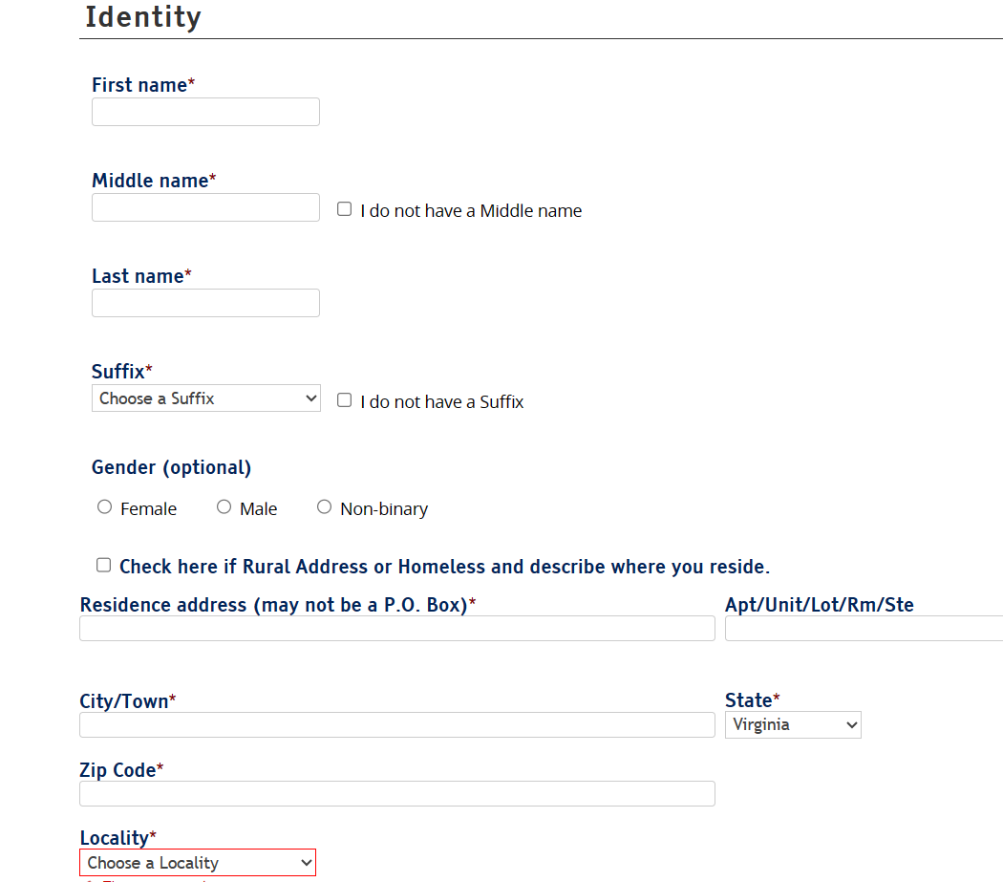
If this information is already filled in, check to make sure it is correct. If it is NOT filled in, enter the information.
Your middle name must be included. If you do not have a middle name, check “I do not have a middle name.”
If you have a suffix, such as Jr. or II, select it. Check “I do not have a Suffix,” if this does not apply to your name.
Be sure to use your legal name.
Your residence is where you sleep at night.
Notes:
Information on this page may already appear based upon information from the DMV. If so, check it for accuracy. If it is not accurate, you will need to type in the correct information.
If there is nothing in the boxes, you will need to type in the correct information. It is important to note that this is our LEGAL first and last name. No nicknames are allowed. Also, if your last name is hyphenated, be sure to include both parts. Be sure to check the box for “I do not have a Middle name” if need be.
Your residence is where you sleep at night, not necessarily where you collect your mail. Be sure to provide both your house/apartment number as well as the full street name.

Slide 13
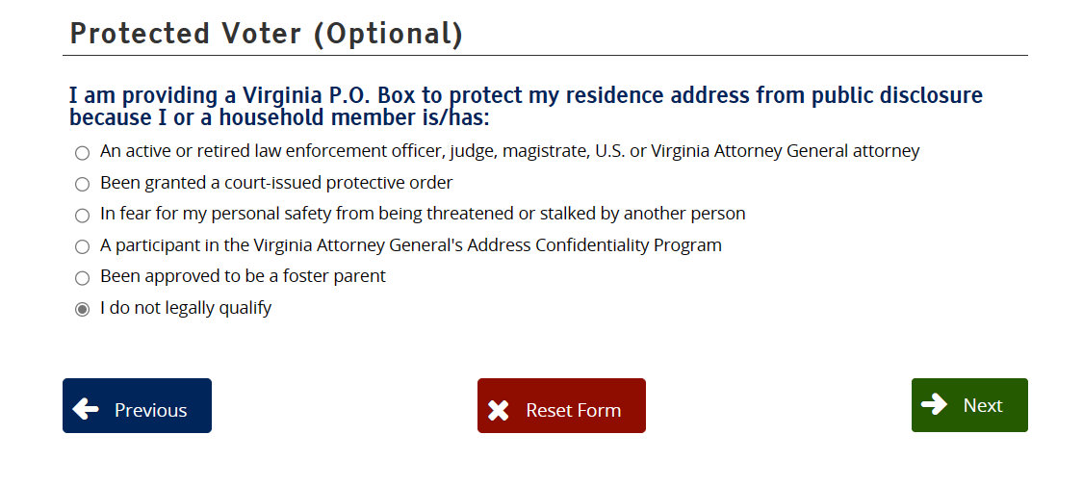
If you are NOT in any of the categories listed, you are not a protected voter.
Leave the pre-selected answer and click Next.
Notes:
This page has pre-selected answers that most likely do not apply to you, and you can leave this page as it is.
Some people are protected voters and do not have to provide their home address, such as people in law enforcement or people who are under court protection. This most likely does not apply to you.

Slide 14
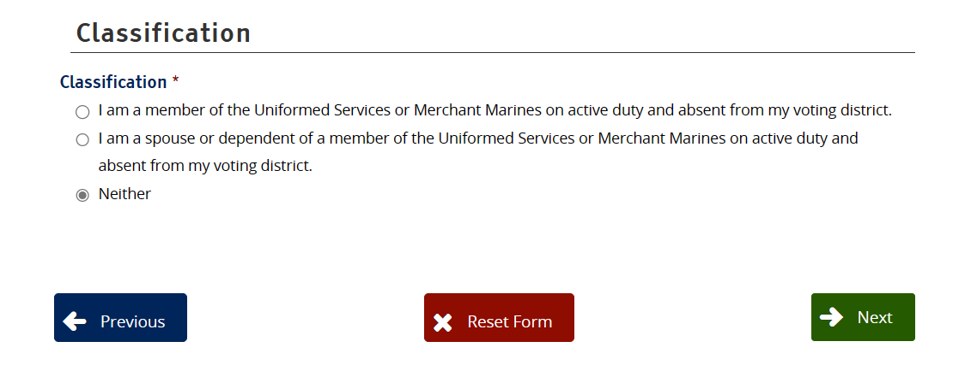
This page is only for people who are on active duty military or military families whose home state is Virginia, but they are not living in Virginia.
If this does not apply to you, leave the pre-selected answer and click Next.
Notes:
This pertains only to active-duty military and their families if their “home state” is Virginia but they are not currently residing here. For example, they might be stationed in Germany but want to register to vote in Virginia as they consider Virginia their “home state”. Since you are now a resident of Fairfax County, this would not pertain to you. Remember that no matter where you are. in the world, as a U.S. citizen you have the right to vote in an election.

Slide 15
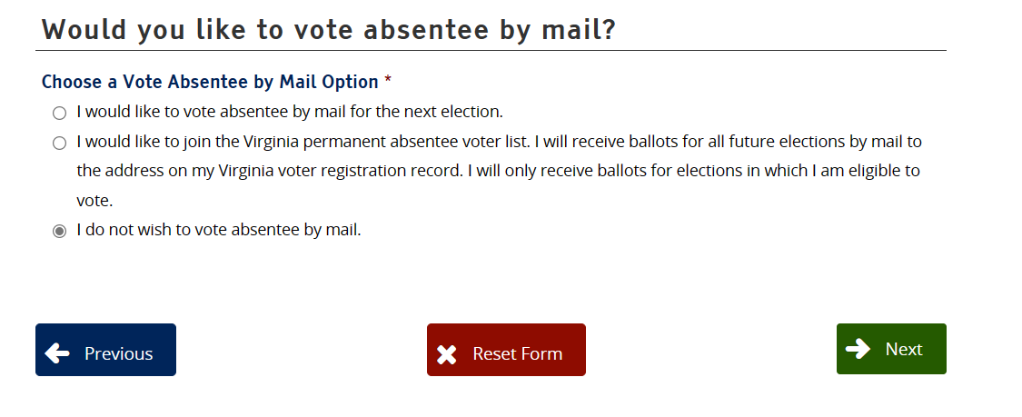
Decide if you want to vote by mail (absentee) or not. The choice of NOT voting by mail (absentee) is selected for you. This means that you want to vote in-person either on Election Day or during Early Voting. If you do want to vote by mail, click on one of the other circles. Then click
Notes:
Under the question, Would you like to vote by mail? the directions ask you to choose an absentee option. This means you need to decide if you want to vote by mail or not. The choice of NOT voting by mail (absentee) is selected for you. This means that you want to vote in-person either on Election Day or during Early Voting. If you do want to vote by mail, click on one of the other circles. If you do request an absentee ballot, we suggest that you check out our presentation on “How to Vote Absentee by Mail” for more information on this process.
Image: Virginia Department of Elections

Slide 16
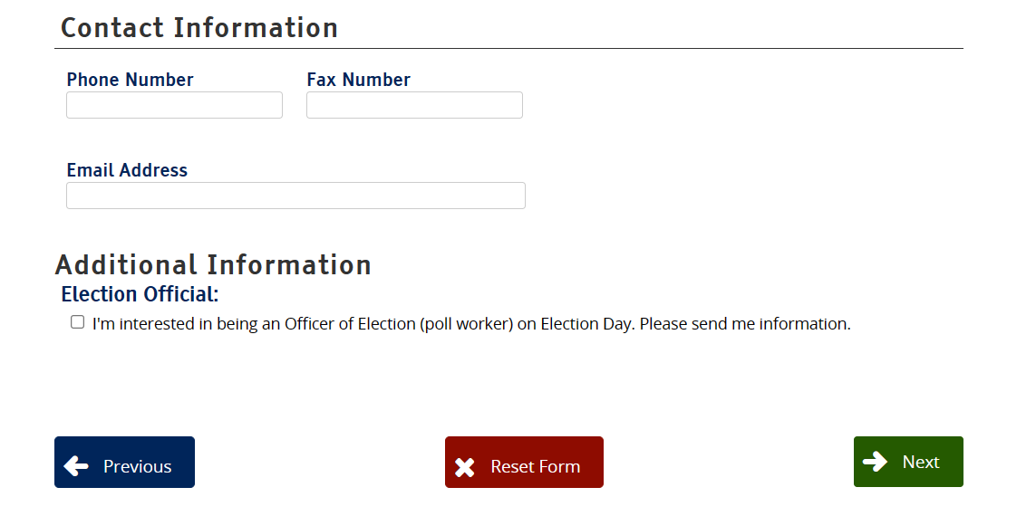
It recommended that you enter your phone number or email address so that you can be contacted if there are any questions.
Check the box if you want to receive information about working at the polls. Then click
Notes:
Your phone number and email address are requested so that the Office of Elections might be able to contact you if there is a question about your registration.
You can also request information about working at the Polls on Election Day. In recent years, more than 350 FCPS students have worked at the polls in Fairfax County.
Image: Virginia Department of Elections

Slide 17
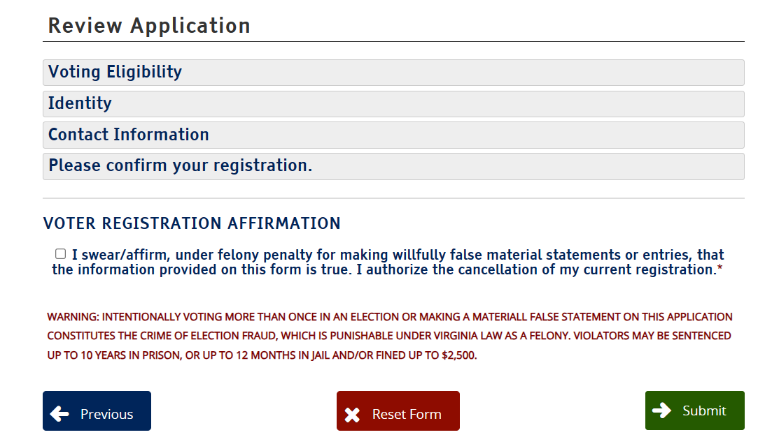
Click to reread the information that you provided.
You must click the box by VOTER REGISTRATION AFFIRMATION. Here you are saying that the information you have provided is correct.
Then click the Submit button
Notes:
Click to review the information that you provided to ensure that it is correct.
You must click the box under: VOTER REGISTRATION AFFIRMATION. Here you are saying that the information you have provided is correct.
Be sure to click the Submit button to finalize our voter registration.
Image: Virginia Department of Elections

Slide 18
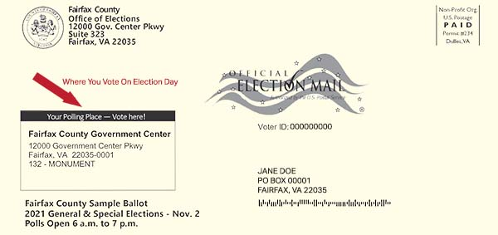
You've submitted your application. Watch for mail!
Within 30 days, you will receive notification. It will include:
A card with your polling place, if successful.
If unsuccessful, an explanation and you will have to try again.
Notes:
Once the application has been submitted, you should receive notice within 30 days from the Office of Elections. If your registration was successful, you will receive a notification that identifies your polling (or voting) place. This is usually a location close to your home. Keep this for your records in case you need it in the future.
If your registration is not successful, the notice will tell you the problem with your application. Then you can try again using the online form or with a paper application form. If you use a paper form, it must be completed correctly and mailed with a stamp on the envelope.
Image:
https://www.freepik.com/free-vector/mailbox-concept-landing-page_5337100.htm#page=7&query=mailbox&position=25
Postcard image from Fairfax County Government News Center, (10/12/2021) https://www.fairfaxcounty.gov/news/every-fairfax-county-voter-receive-personalized-sample-ballot

Slide 19
“Where is my polling place?”
“Can I vote early?”
“Where can I apply for an absentee ballot?”
“Who is running?”
“What's on the ballot?”
“How can I get a voter’s guide?”
A voter’s guide is resource compiling candidate responses/stances on important issues. Reviewing your voter’s guide before voting can help you be a more informed voter!
Questions about voting or candidates? Use this source of non-partisan, reliable informaiton.
Vote411.org
Notes:
Once you are registered, it is important to be informed about the issues and candidates which may appear on the ballot you will be using. While there are many sources of information, there may also be misinformation about the candidates and the election. One place to find non-partisan information is Vote411.org.
Vote 411.org is a nationwide, nonpartisan website that has lots of the needed information to answer questions you may have, so you can make careful and informed decisions when you vote. Enter your name and address and you will get information about who is running for office in your area, when the election will be held, and other issues that will be on your ballot when you go to vote. You can also check to make sure you are registered and locate your polling place.

Slide 20
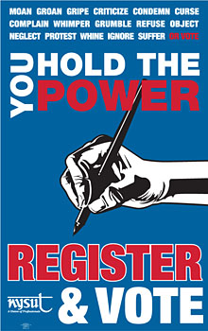
Remember to:
Register to vote.
Urge your friends and family to register.
Become informed about candidates and issues.
Vote! AND
Encourage others to Vote!
Notes:
Voting is a right that should not be taken for granted. Voting is an opportunity to make your voice heard. Many people have fought, and some have even died for this right.
Voting is your right and responsibility as a citizen of the United States.
Register to vote and urge your friends and family to become registered.
Become an informed citizen about the candidates and issues before your vote.
Help to Get out the Vote by encouraging others to vote!
Voting is your Power!
Image: Used by Permission from the New York State United Teachers

